Slide 1
Chapter Fifteen
Government Policies Affecting Family Well-Being

Slide 2
Tables

Slide 3
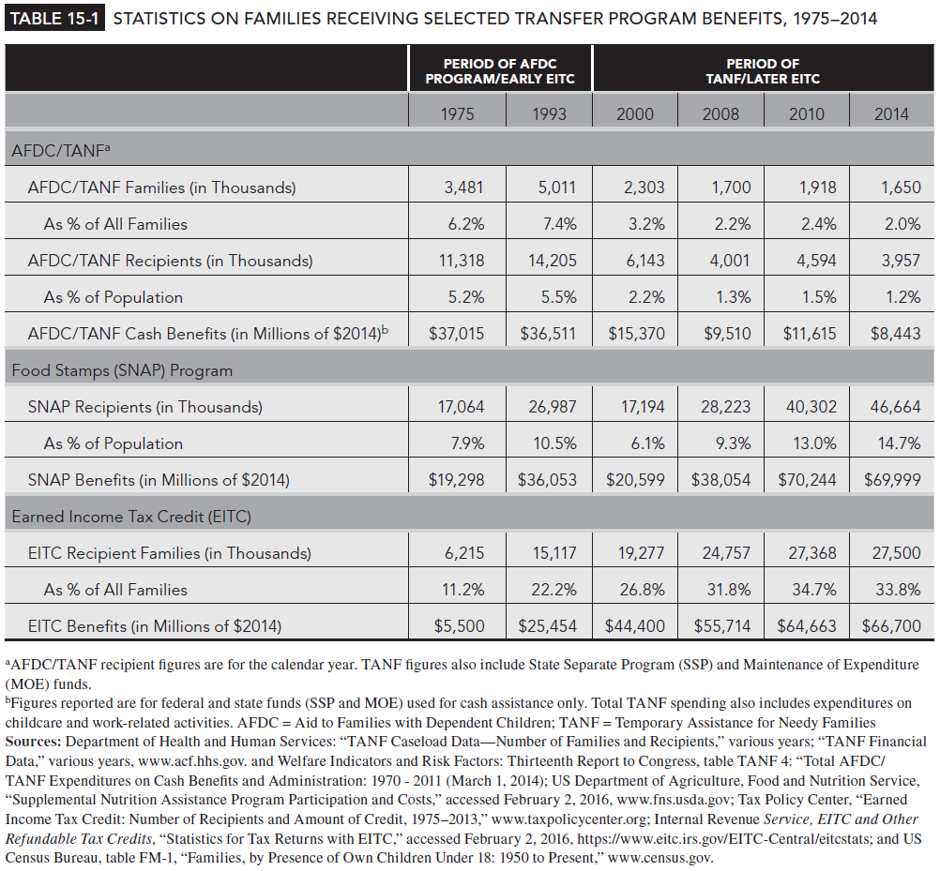
Table 15-1

Slide 4
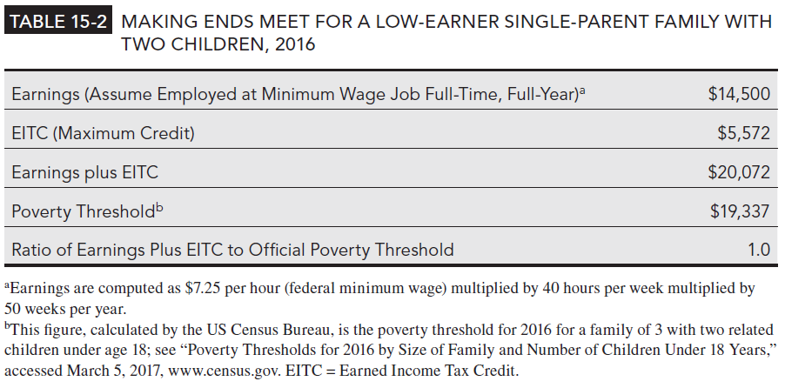
Table 15-2

Slide 5
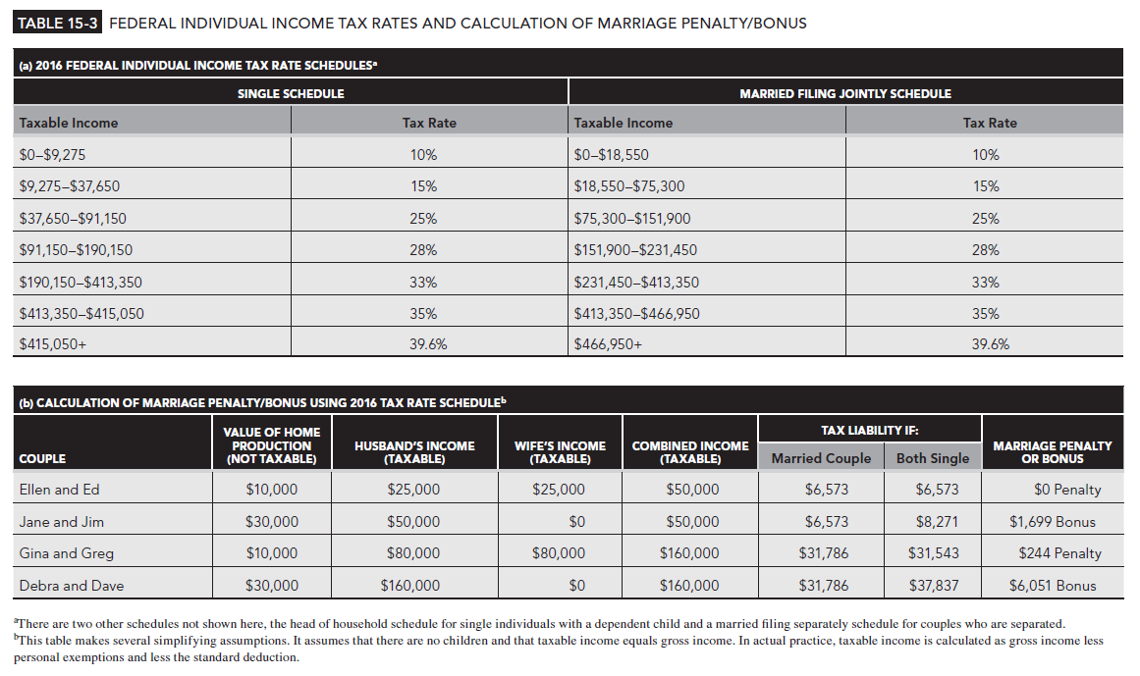
Table 15-3

