Slide 1
Chapter Four
The Family as an Economic Unit: Evidence

Slide 2
Tables

Slide 3
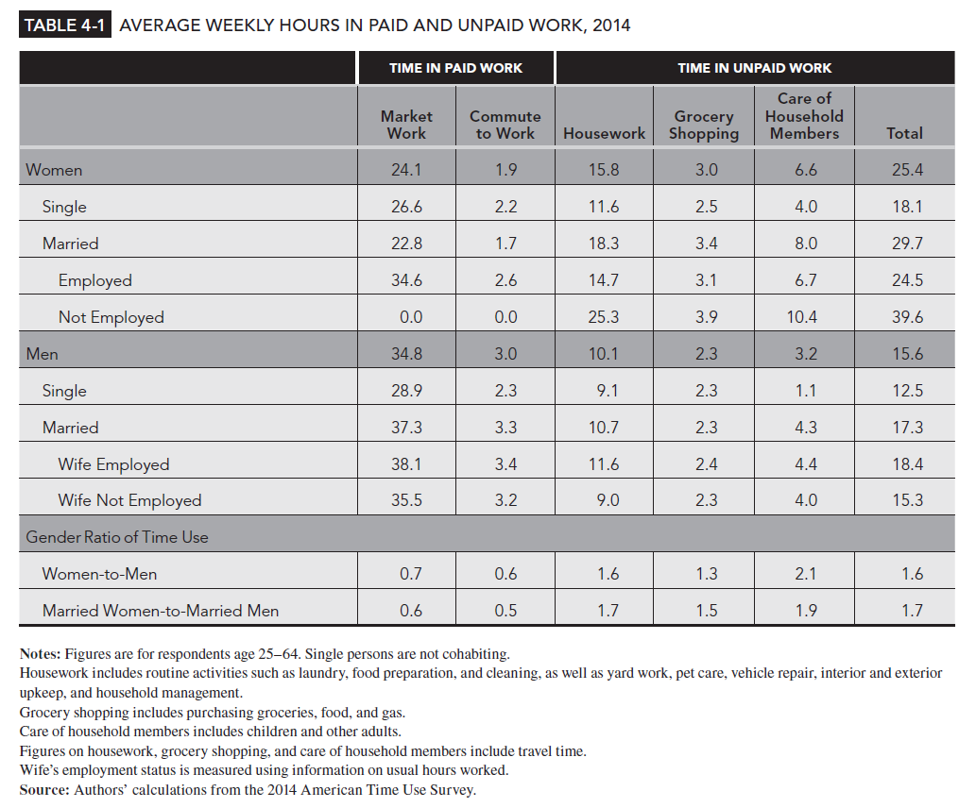
Table 4-1

Slide 4
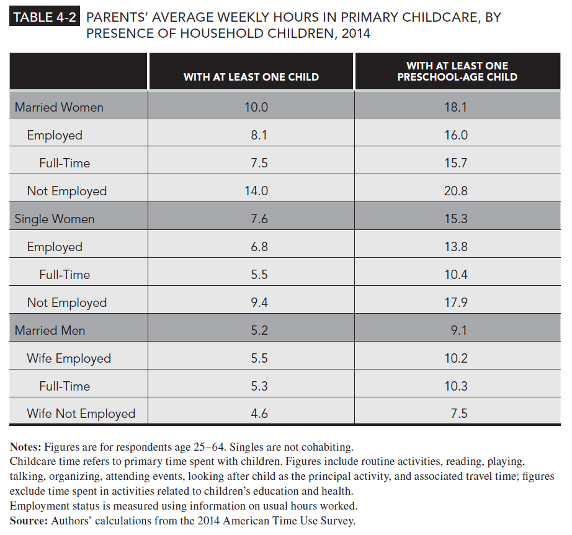
Table 4-2

Slide 5
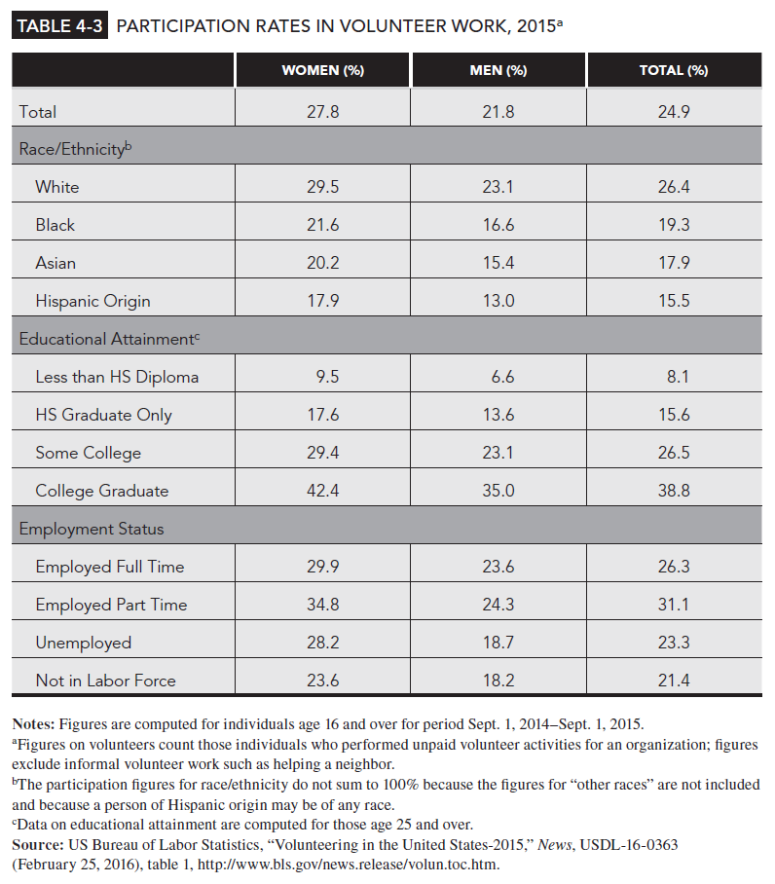
Table 4-3

Slide 6
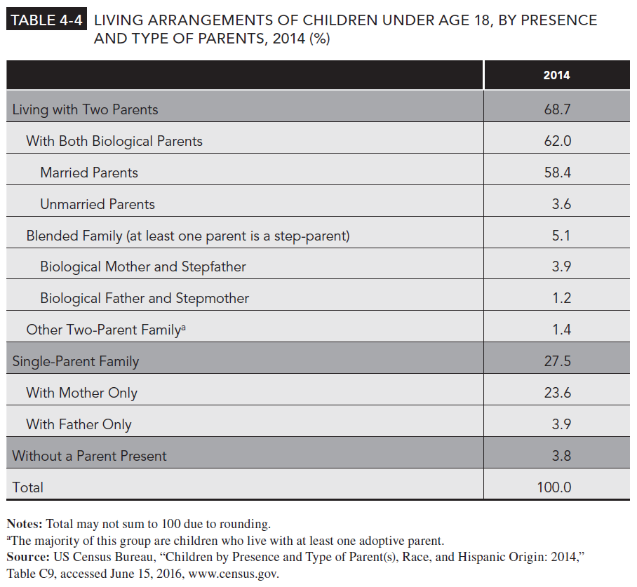
Table 4-4

Slide 7
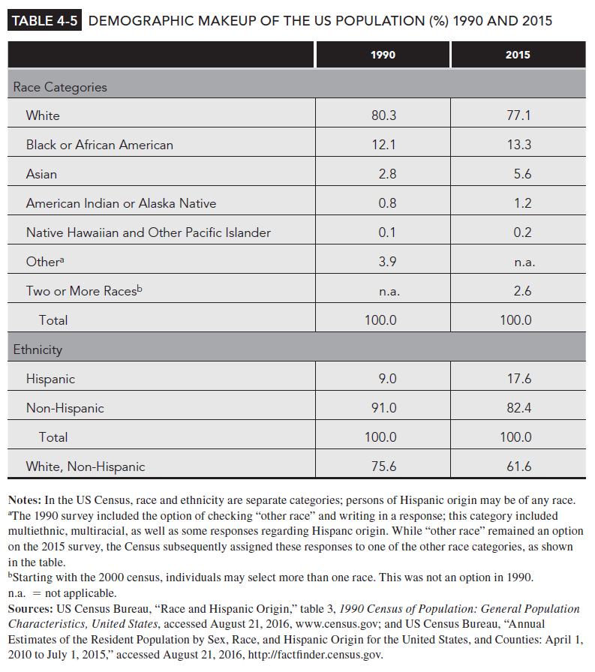
Table 4-5

