Slide 1
Chapter Eighteen
A Comparison of the United States to Other Economically Advanced Countries

Slide 2
Figures and Tables

Slide 3
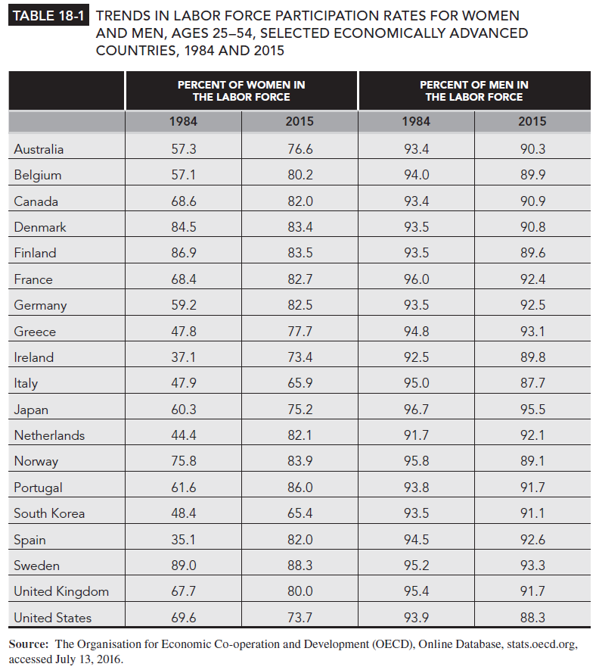
Table 18-1

Slide 4
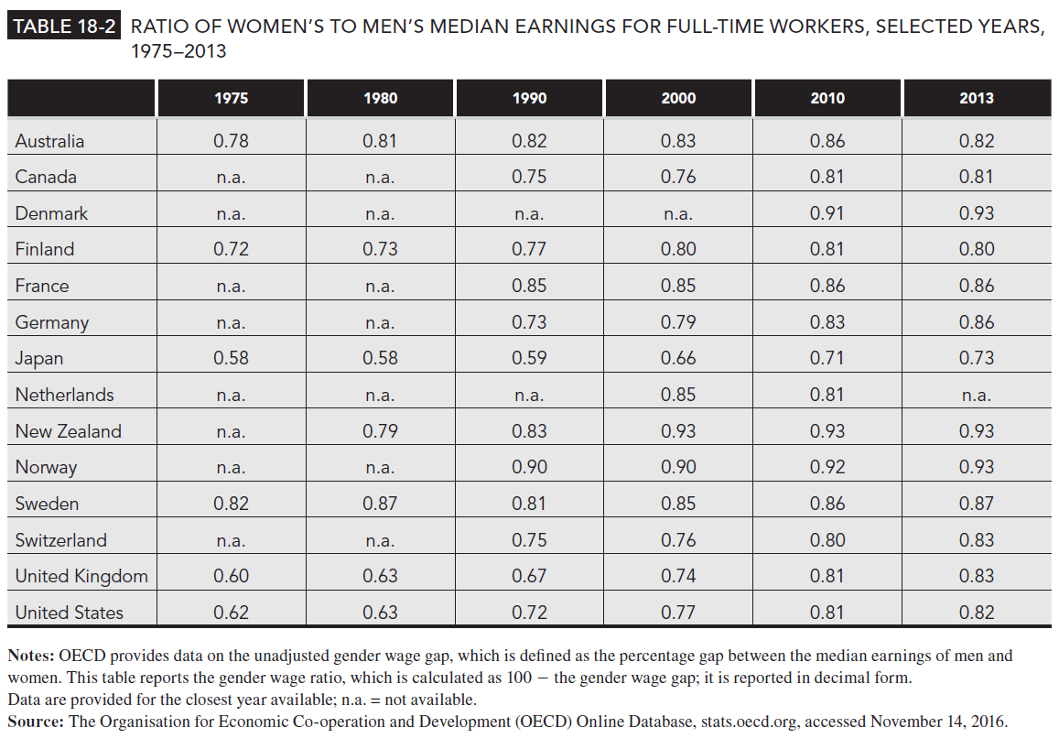
Table 18-2

Slide 5
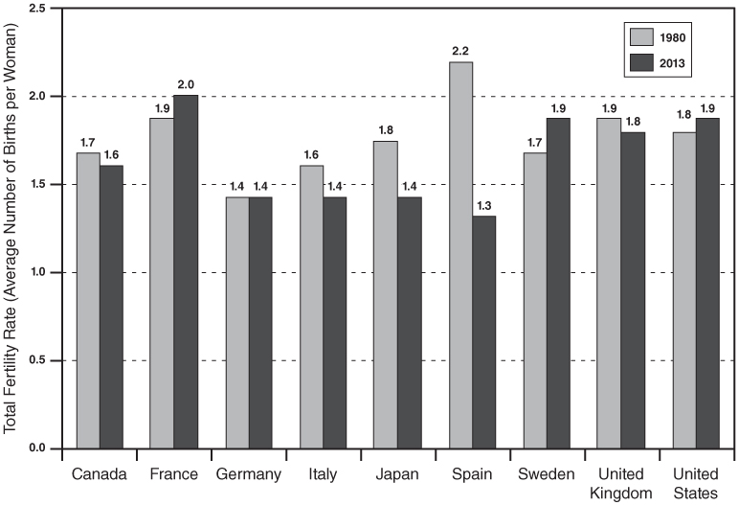
Figure 18-1
Total Fertility Rates, Selected Economically Advanced Countries, 1980 and 2013
Note: The total fertility rate is defined as the number of births that a cohort of 1,000 women would have if they experienced the age-specific birth rates occurring in the current year throughout their childbearing years (see Table 13-4). Here it is divided by 1,000 to measure average number of births per woman.
Source: Fertility rates are from World Bank, World Development Indicators, Online Database, accessed November 15, 2016, www.worldbank.org.

