Slide 1
Chapter Seventeen
Gender Differences Around the World

Slide 2
Figures and Tables

Slide 3
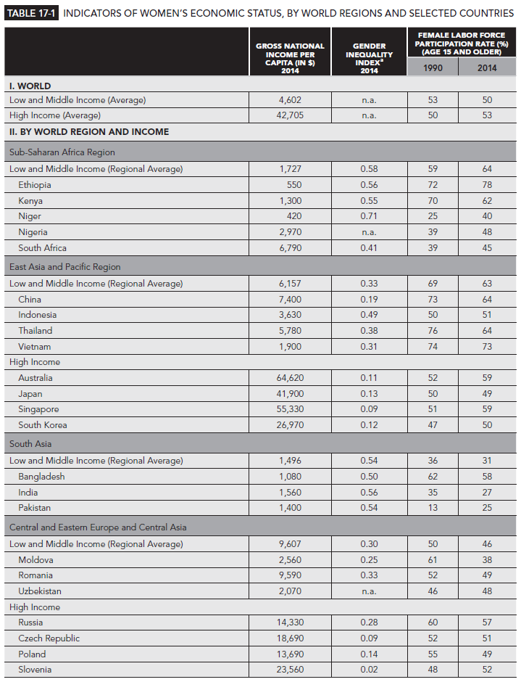
Table 17-1
1 of 4

Slide 4
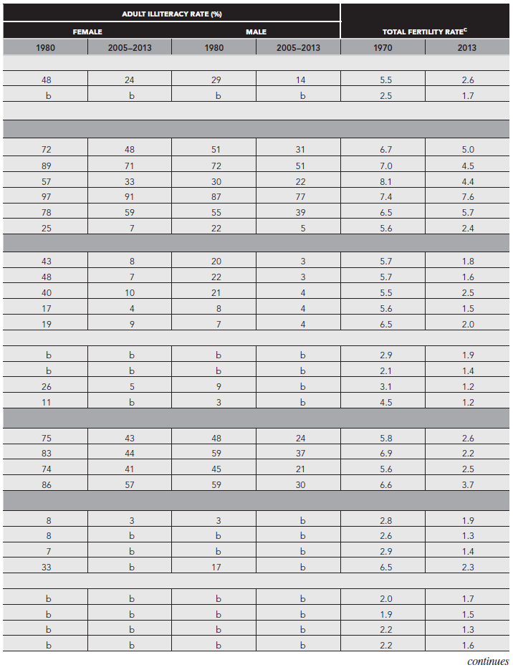
Table 17-1
2 of 4

Slide 5
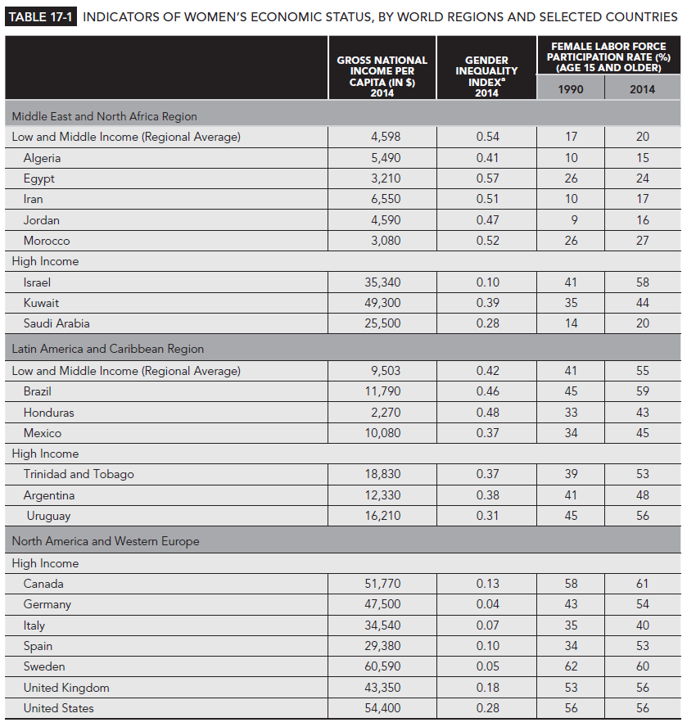
Table 17-1
3 of 4

Slide 6
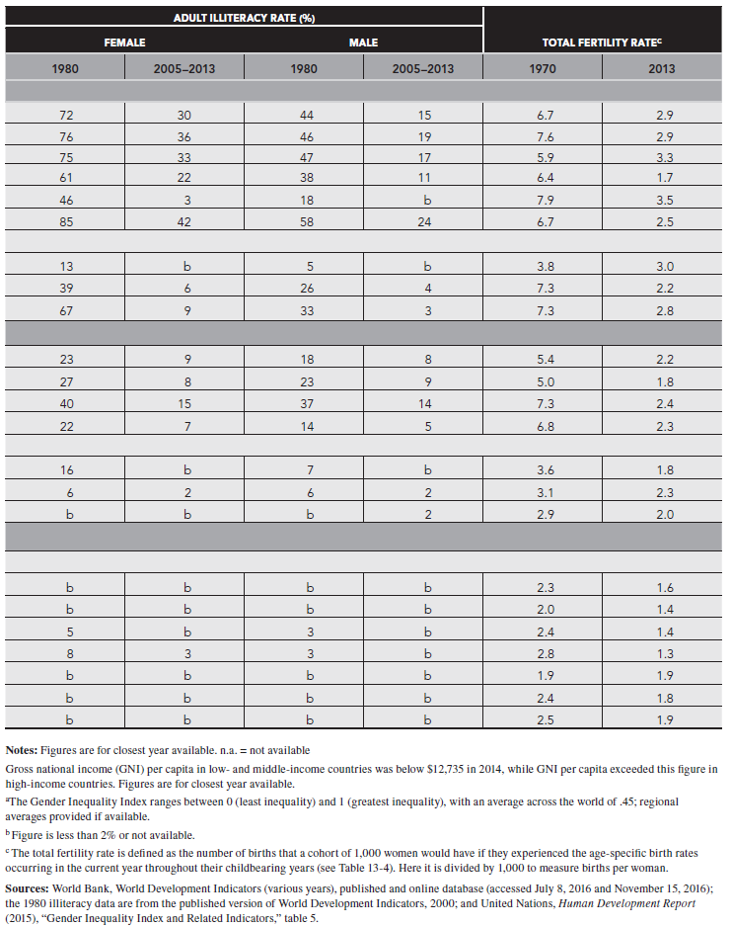
Table 17-1
4 of 4

Slide 7
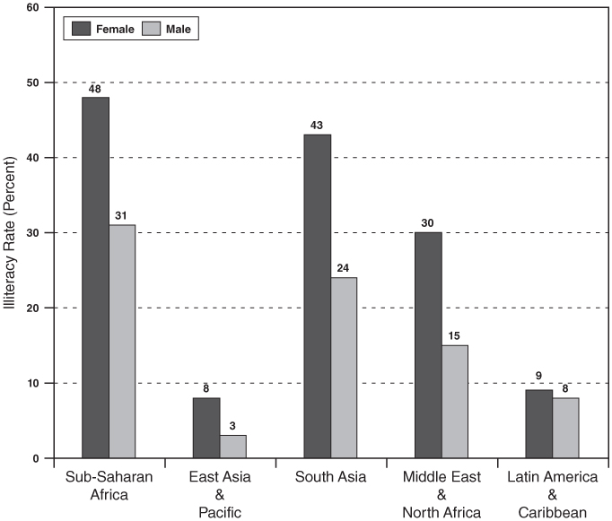
Figure 17-1
Illiteracy Rates, Low & Middle-Income Economies, World Regions, 2013
Note: See Table 17-1 for notes and sources

Slide 8
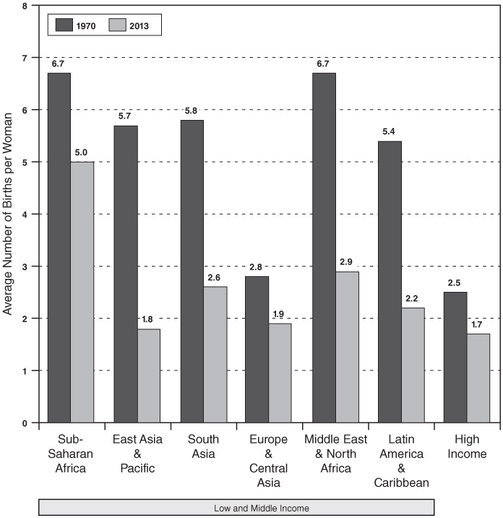
Figure 17-2
Total Fertility Rates, World Regions, 1970 and 2013
Note: See Table 17-1 for notes and sources

Slide 9
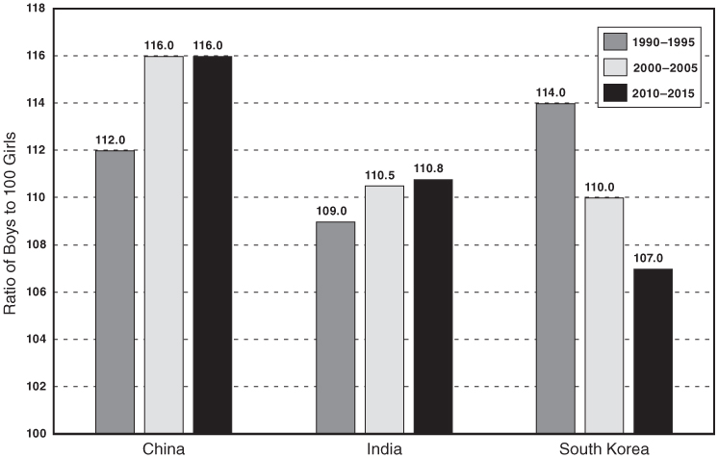
Figure 17-3
Sex Ratios at Birth for China, India, and South Korea, Selected Years
Note: At normal rates, the sex ratio is expected to be about 105-106; the ratio for the United States is 105.
Source: United Nations, World Population Prospects: The 2015 Revision (New York: UN 2015), available from www.un.org, accessed November 14, 2016.

