Slide 1
Chapter Eleven
Labor Market Discrimination: Theory

Slide 2
Figures

Slide 3
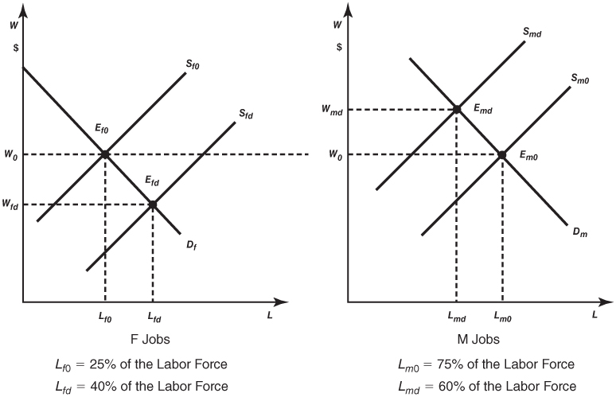
Figure 11-1
An Illustration of the Overcrowding Model

Slide 4
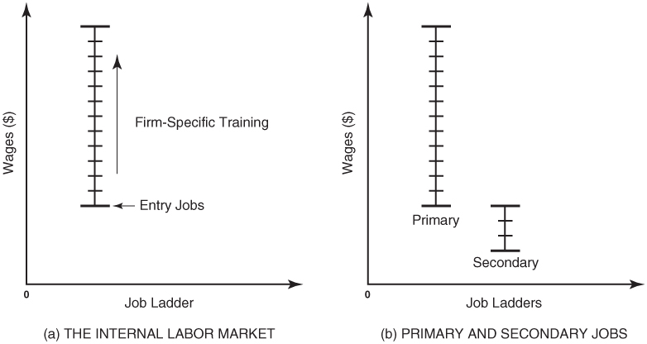
Figure 11-2
An Illustration of the Institutional Model

Slide 5
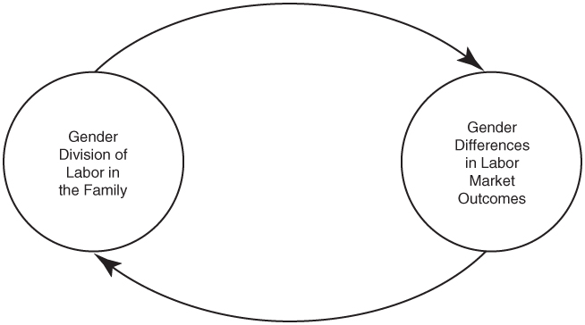
Figure 11-3
An Illustration of Feedback Effects

