Slide 1
Chapter Nine
Other Supply-Side Sources of Gender Differences in Labor Market Outcomes

Slide 2
Figures

Slide 3
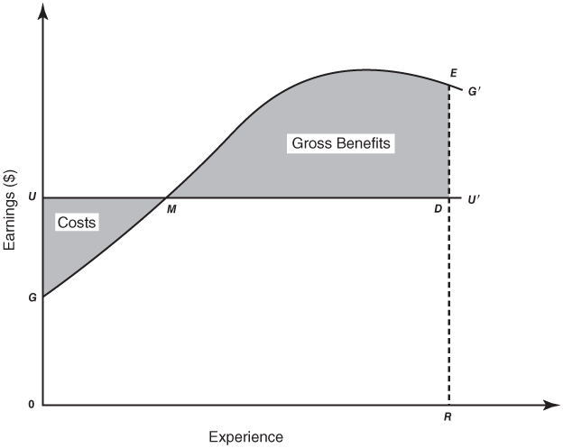
Figure 9-1
The On-the-Job Training Investment Decision: General Training

Slide 4
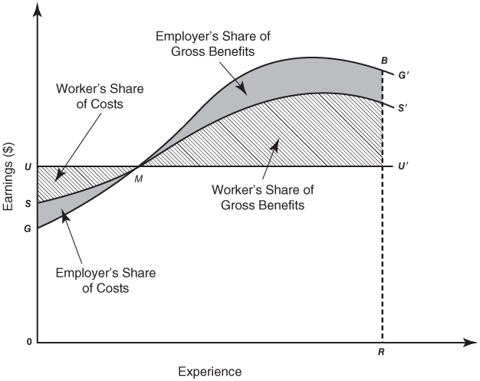
Figure 9-2
The On-the-Job Training Investment Decision: Firm-Specific Training

Slide 5
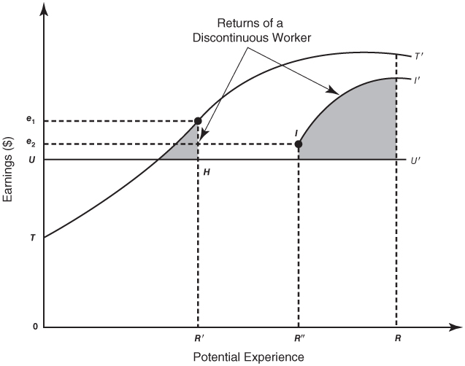
Figure 9-3
The Impact of Expected Work Life on the Training Investment Decision

Slide 6
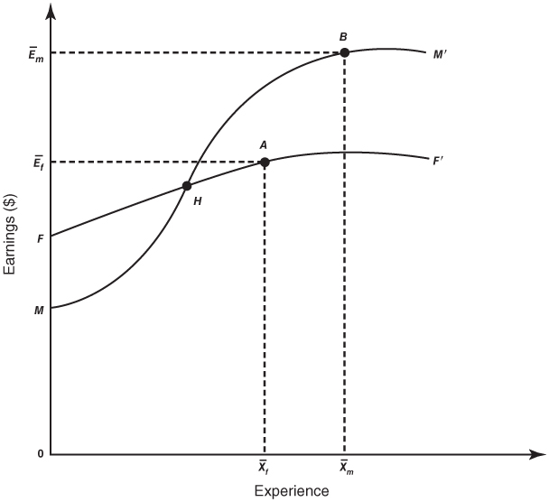
Figure 9-4
The On-the-Job Training and Sex Differences in Occupations and Earnings

