Slide 1
Chapter Eight
Gender Differences in Educational Attainment: Theory and Evidence

Slide 2
Figures and Tables

Slide 3
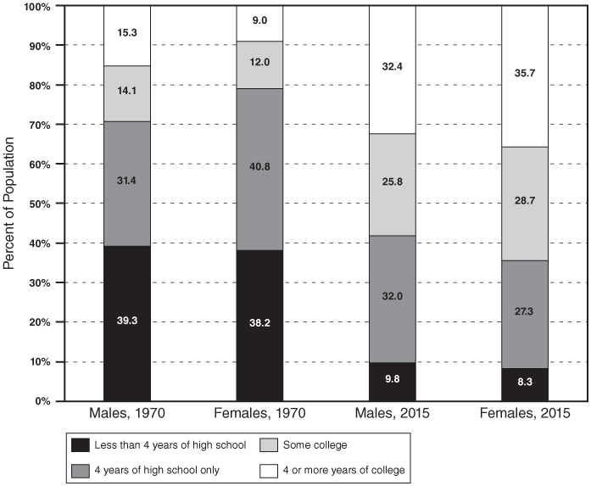
Figure 8-1
Educational Attainment of the Population by Gender (Percent): 1970 and 2015 (Ages 25-64)
Notes: In making the 1970 and 2015 data compatible, we follow the suggestions of David A. Jaeger, “Reconciling the Old and New Census Bureau Education Questions: Recommendations for Researchers,” Journal of Business and Economic Statistics 15, no.3 (July 1997): 300-09. In particular, individuals with a high school degree and those with 4 years of high school but no degree are both coded as having 4 years of high school only.
Source: Tabulated from the 1970 and 2015 microdata files of the March CPS.

Slide 4
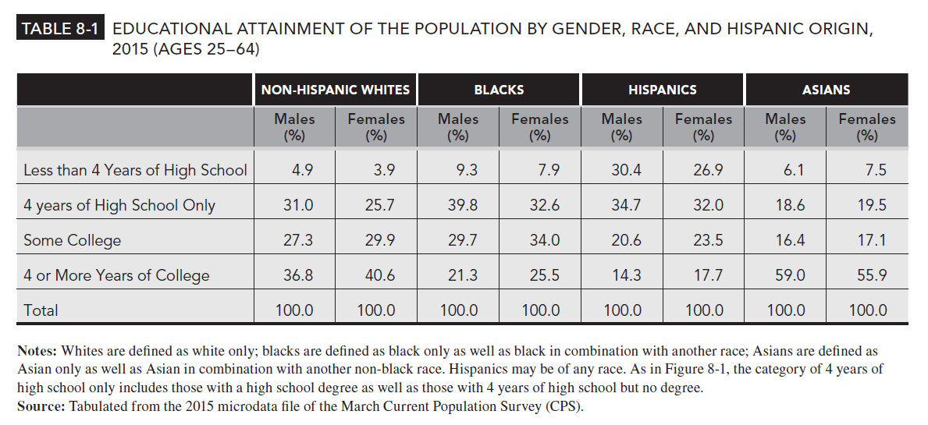
Table 8-1

Slide 5
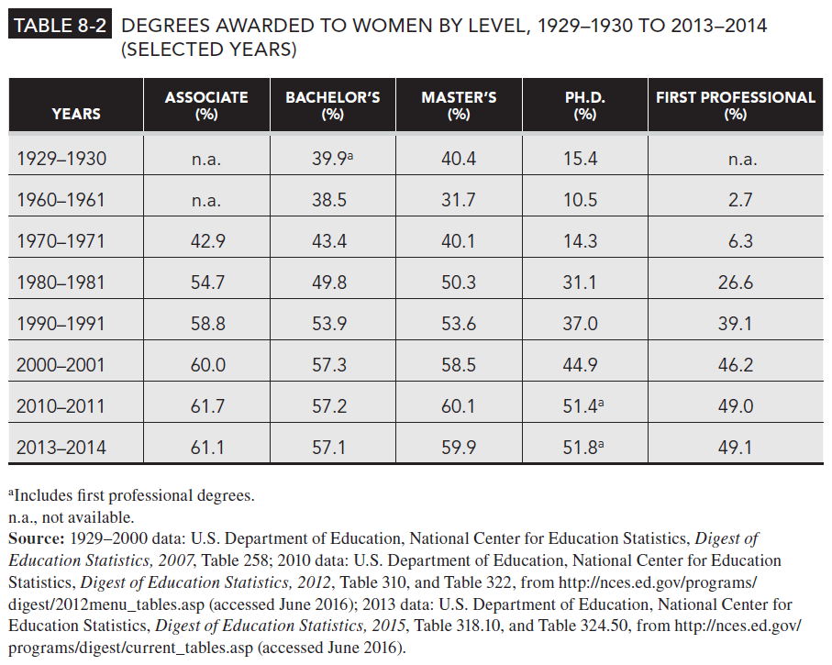
Table 8-2

Slide 6
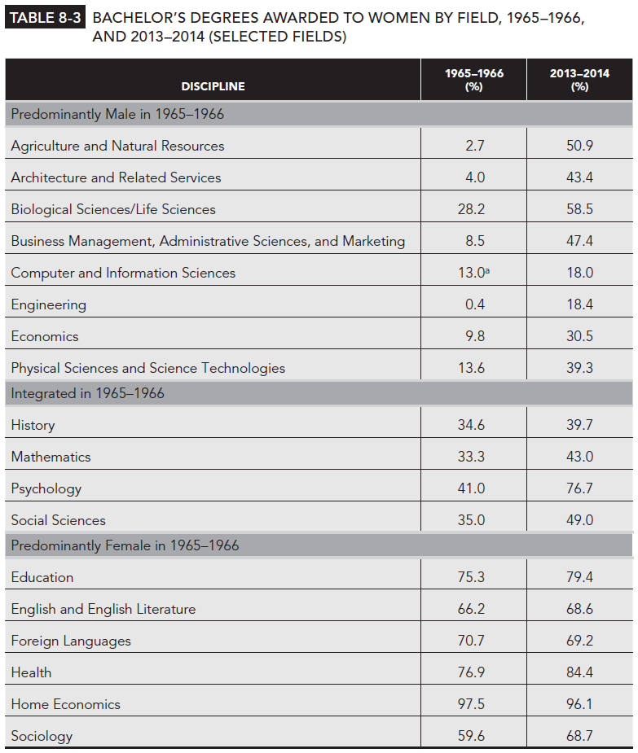
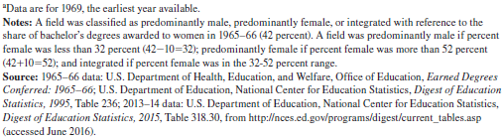
Table 8-3

Slide 7
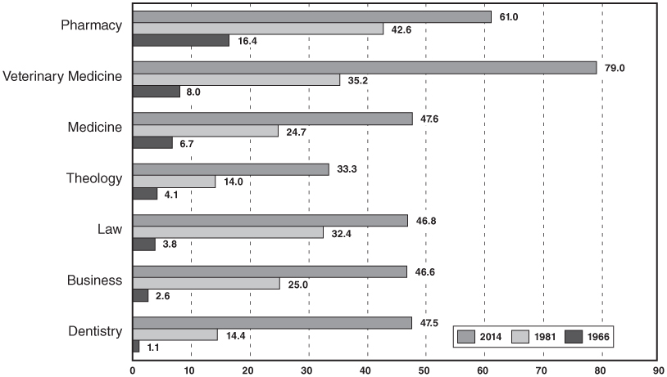
Figure 8-2
Percent of First Professional Degrees Awarded to Women by Field, 1966, 1981, and 2014 (Selected Fields)
Notes: Business refers to masters degrees in business. Data for Pharmacy in 1966 comes from academic year 1967-1968.
Source: US Department of Health, Education and Welfare, Office of Education, Earned Degrees Conferred: 1965-66; US Department of Education, National Center for Educational Statistics, Digest of Education Statistics, 1983 and 2015, from http://nces.ed.gov/programs/digest/current_tables.asp (accessed June 2016).

Slide 8
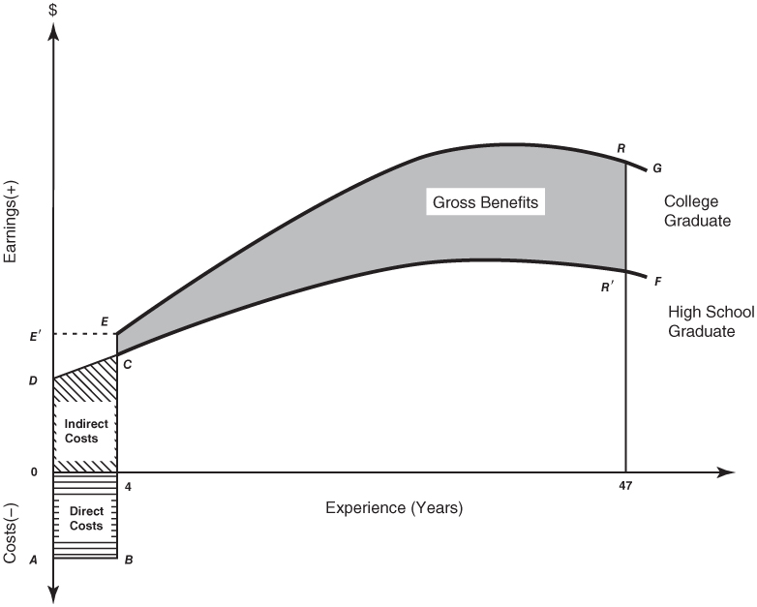
Figure 8-3
The Educational Investment Decision

Slide 9
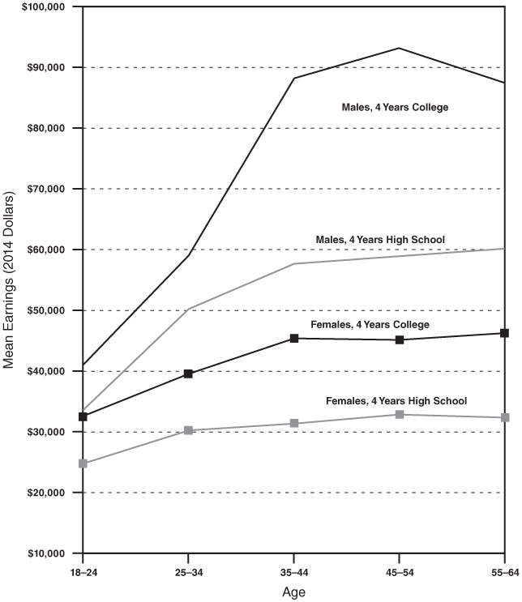
Figure 8-4a
Age-Earnings Profiles of Year-Round, Full-Time Workers by Gender and Education, 1974 (2014 Dollars)

Slide 10
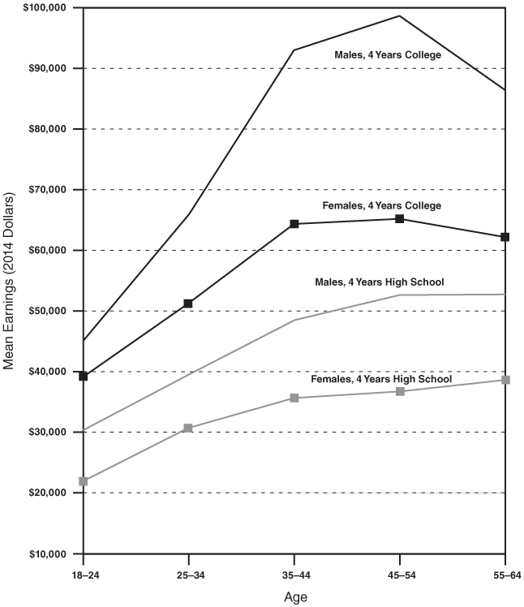
Figure 8-4b
Age-Earnings Profiles of Year-Round, Full-Time Workers by Gender and Education, 2014 (2014 Dollars)
Sources: US Census Bureau Historical Income Tables – People, Table P-32 “Educational Attainment – Full-Time, Year-Round Workers 18 Years Old and Over by Mean Earnings, Age, and Sex: 1974 to 1979” from https://www.census.gov/data/tables/time-series/demo/income-poverty/historical-income-people.html (accessed June 2016).

Slide 11
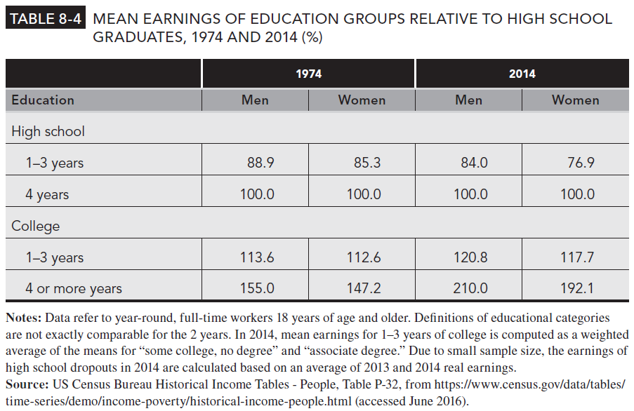
Table 8-4

Slide 12
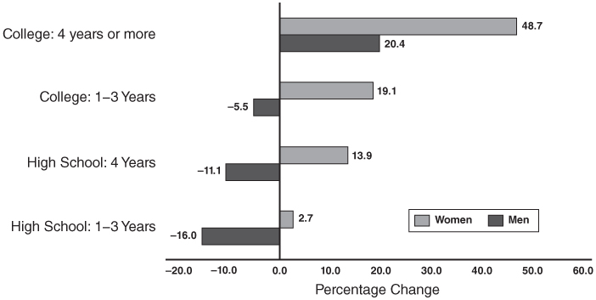
Figure 8-5
Percent Change in Real Mean Earnings of Men and Women by Education for Year-Round, Full-time Workers, 1974-2014
Notes: Data refer to year-round, full time workers 18 years of age and older. Definitions of educational categories are not exactly comparable for the 2 years. In 2014, mean earnings for 1-3 years of college is computed as a weighted average of the means for “some college, no degree” and “associate degree”. Adjusted for inflation using the Consumer Price Index for All Urban Areas (CPI-U-RS). Due to small sample size, the earnings of high school dropouts for 2014 are calculated as an average of 2013 and 2014 real earnings.
Sources: US Census Bureau Historical Income Tables – People, Table P-32 and P-35 from https://www.census.gov/data/tables/time-series/demo/income-poverty/historical-income-people.html (accessed June 2016).

Slide 13
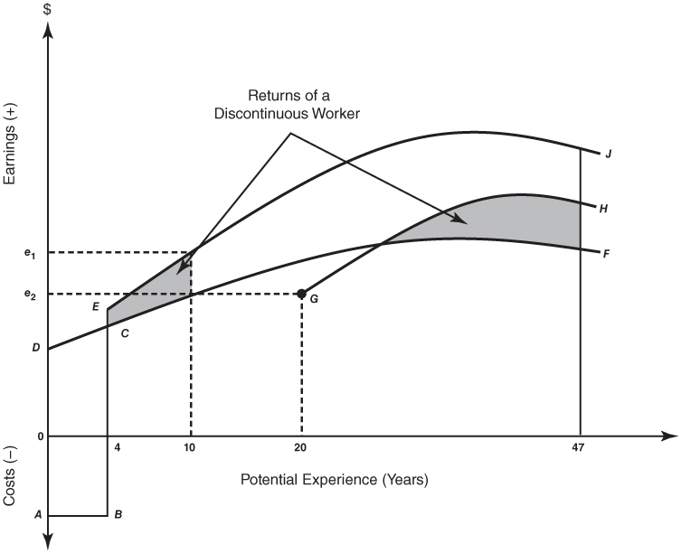
Figure 8-6
The Impact of Expected Work Life on the Educational Investment Decision

