Slide 1
Chapter Seven
Evidence on Gender Differences in Labor Market Outcomes

Slide 2
Figures and Tables

Slide 3
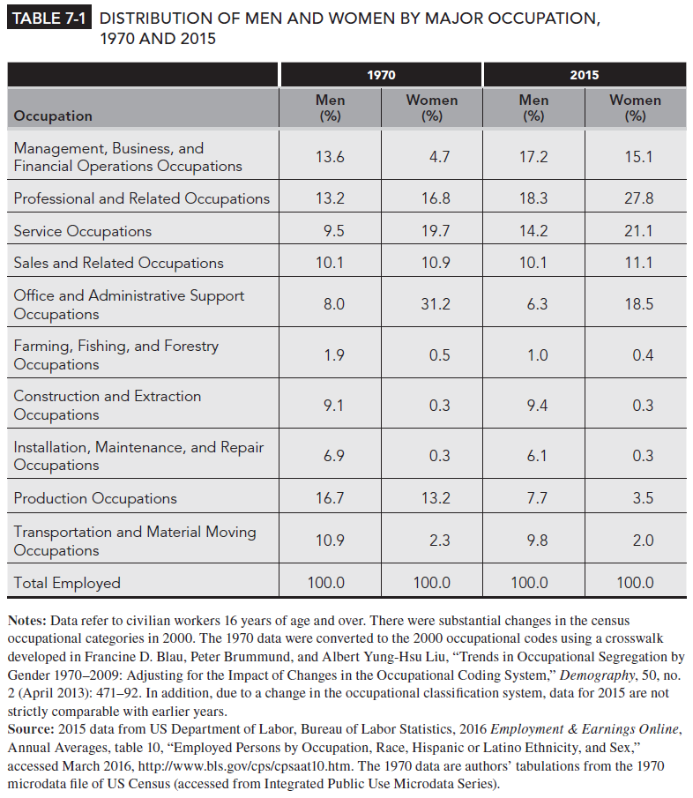
Table 7-1

Slide 4
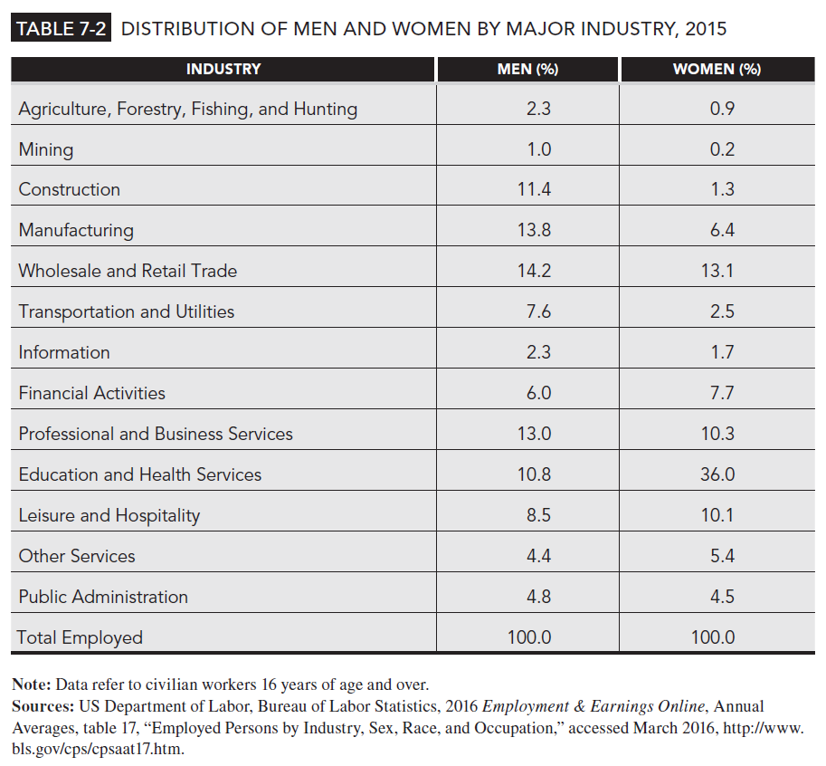
Table 7-2

Slide 5
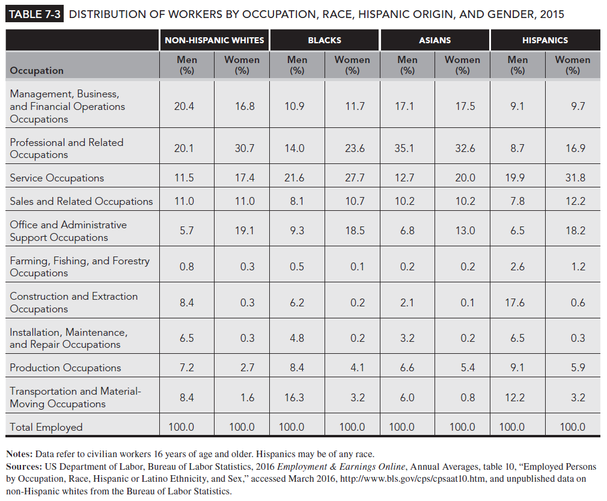
Table 7-3

Slide 6
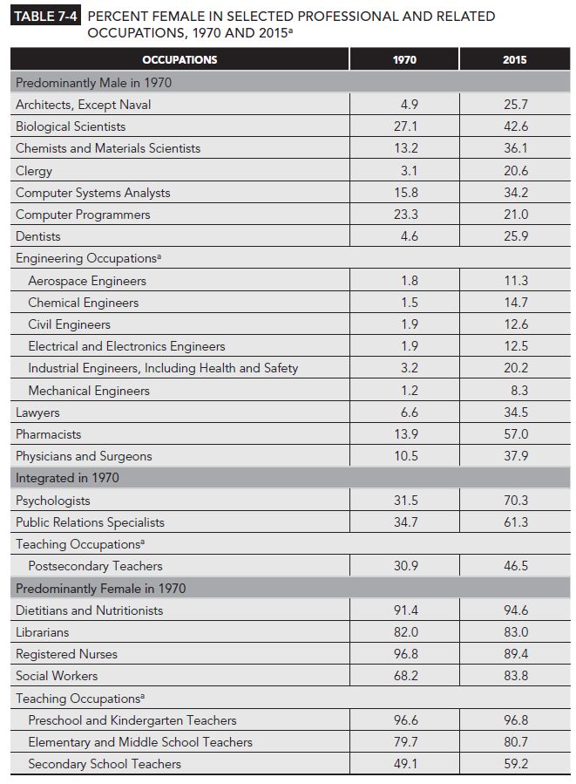
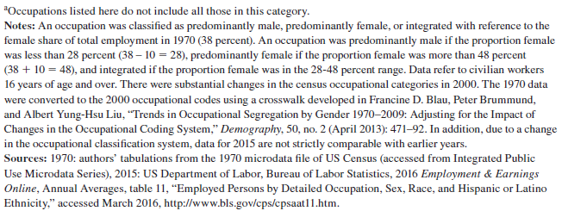
Table 7-4

Slide 7
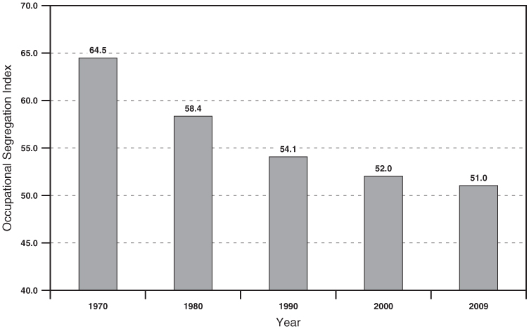
Figure 7-1
Trends in Occupational Segregation by Sex, 1970-2009
Source: Francine D. Blau, Peter Brummund, and Albert Yung-Hsu Liu, “Trends in Occupational Segregation by Genfer 1970-2009: Adjusting for the Impact of Changes in the Occupational Coding System,” Demography 50, no.2 (April 2013): 471-92, Table 2.

Slide 8
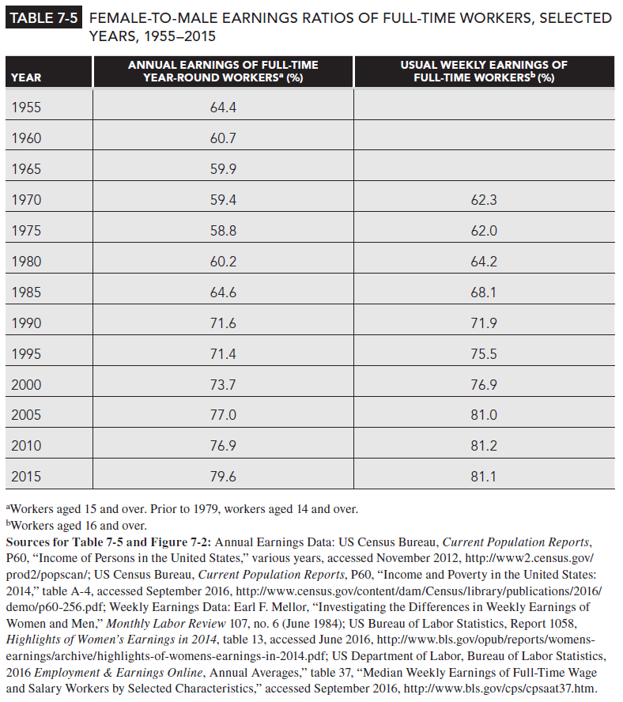
Table 7-5

Slide 9
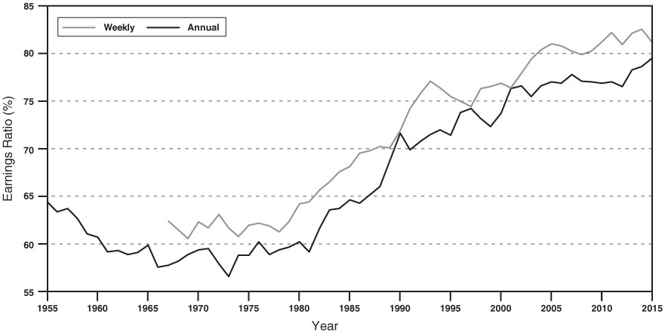
Figure 7-2
Gender Earnings Ratios of Full-Time Workers 1955-2015
Source: See Table 7-5

Slide 10
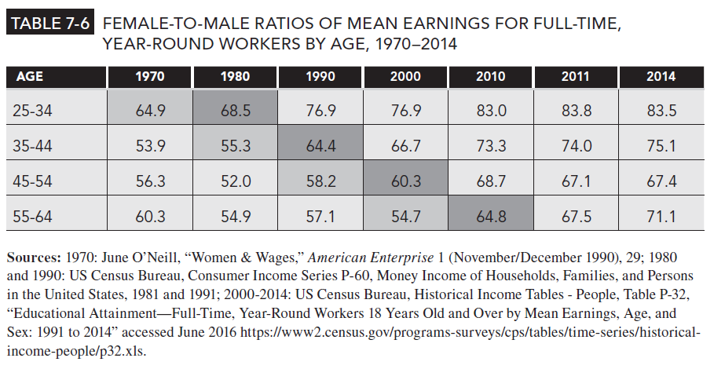
Table 7-6

Slide 11
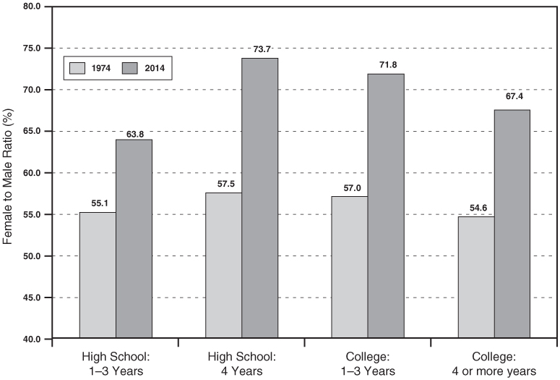
Figure 7-3
Ratio of Female-to-Male Mean Earnings by Education for Workers 18 Years Old and Over, 1974 and 2014
Notes: Definitions of Educational Categories are not exactly comparable for the two years. In 2014, mean earnings for 1-3 years of college is computed as a weighted average of the means for “some college, no degree” and “associate degree”
Source: 1974: US Census Bureau Historical Income Tables-People Series, Table P-35, from www.census.gov/hhes/www/income/data/historical/people/, accessed August 2012; 2014: CPS 2012 Annual Social and Economic Supplement, Table PINC-04, accessed June 2016, https://www.census.gov/data/tables/time-series/demo/income-poverty/cps-pinc/pinc-04.2014.html.

Slide 12
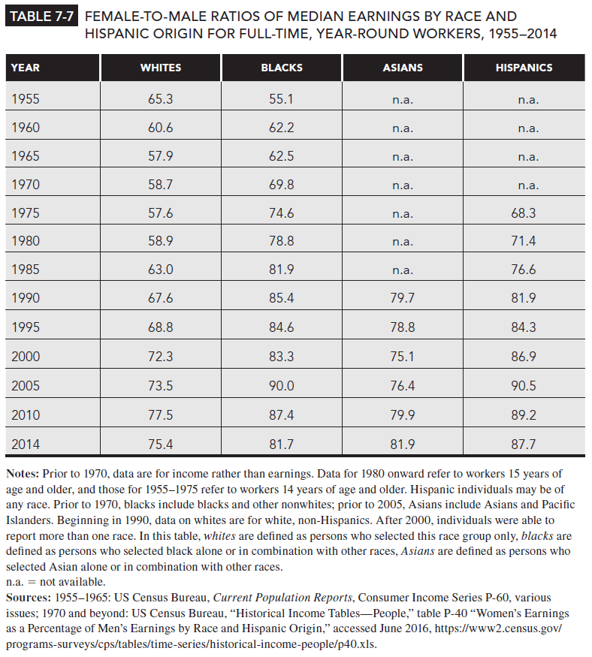
Table 7-7

Slide 13
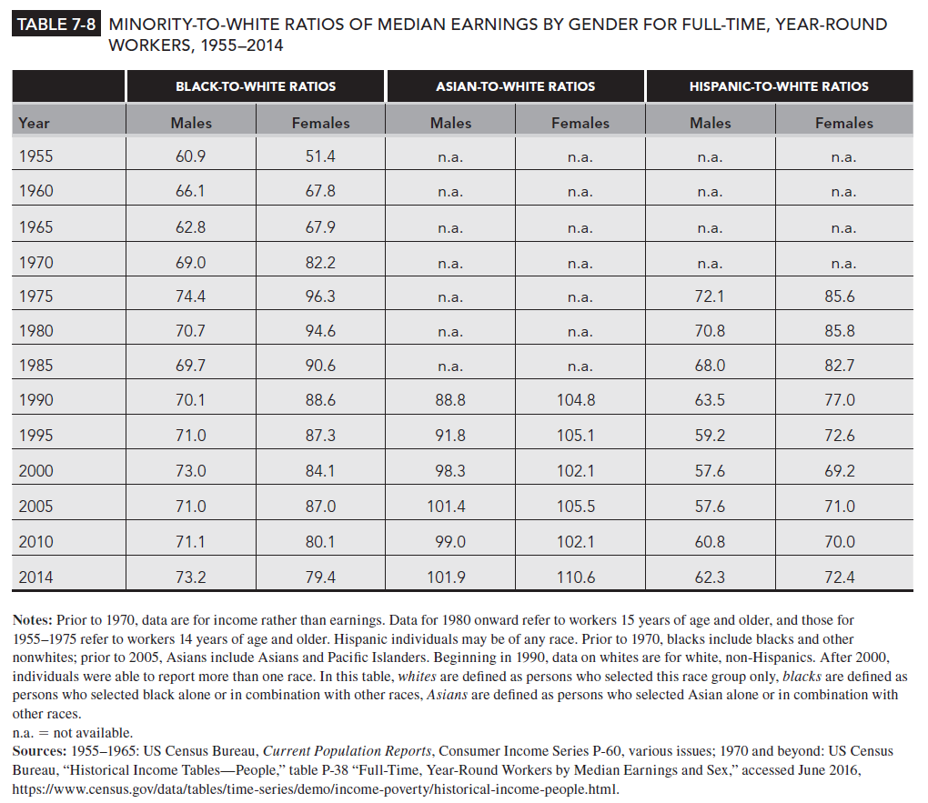
Table 7-8

Slide 14
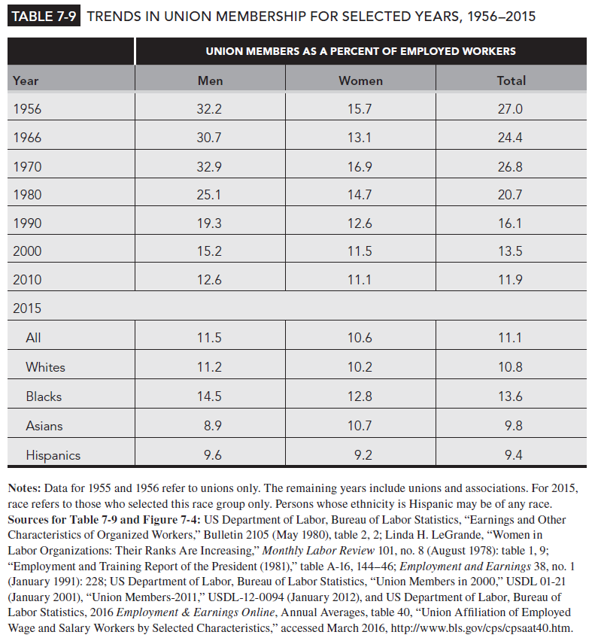
Table 7-9

Slide 15
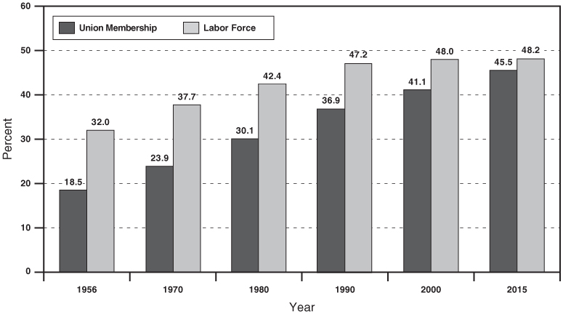
Figure 7-4
Women’s Share of All Employed Workers and Share of Union Membership, 1956-2015
Notes: Data for 1995 and 1956 refer to unions only. The remaining years include unions and associations. For 2015, race refers to those who selected this race group only. Persons whose ethnicity is Hispanic may be of any race.
Source: See Table 7-9 for Sources

Slide 16
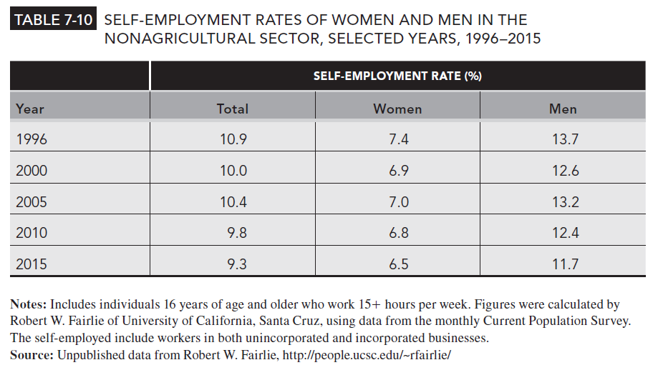
Table 7-10

