Slide 1
Chapter Five
The Labor Force: Definitions and Trends

Slide 2
Figures and Tables

Slide 3
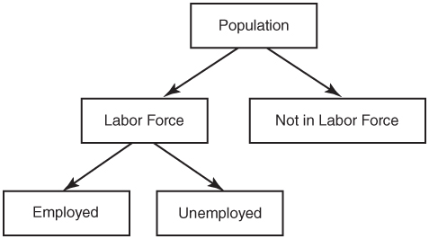
Figure 5-1
An Illustration of Labor Force Definitions

Slide 4
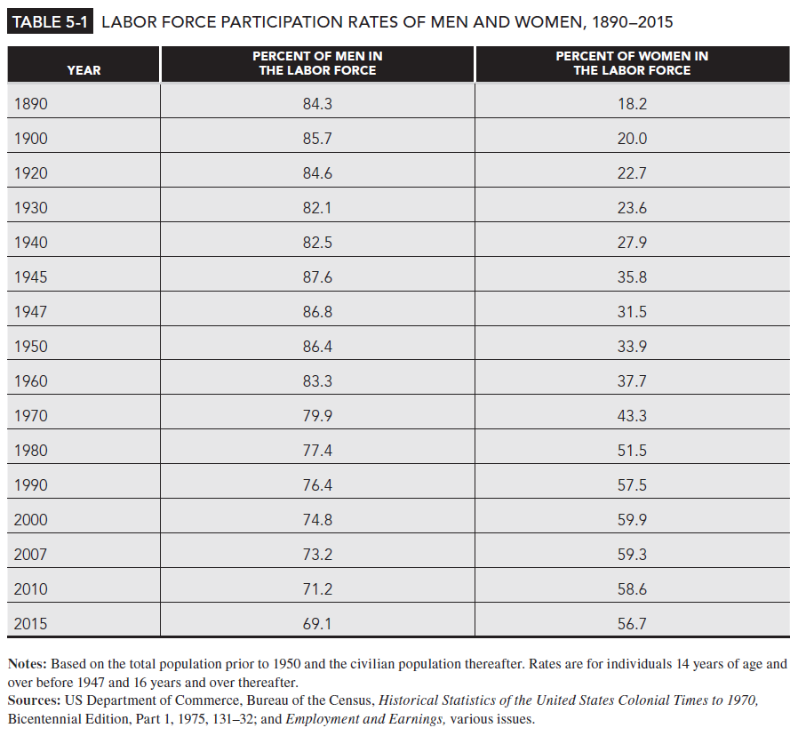
Table 5-1

Slide 5
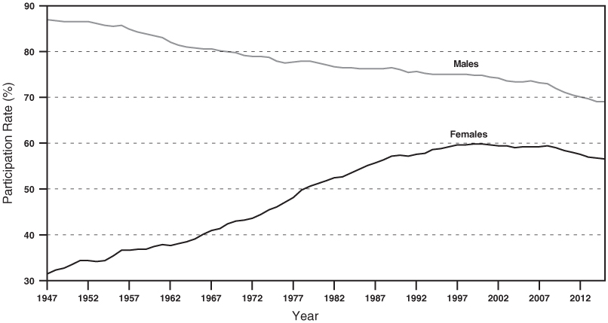
Figure 5-2
Trends in Female and Male Labor Force Participation Rates, 1947-2015

Slide 6
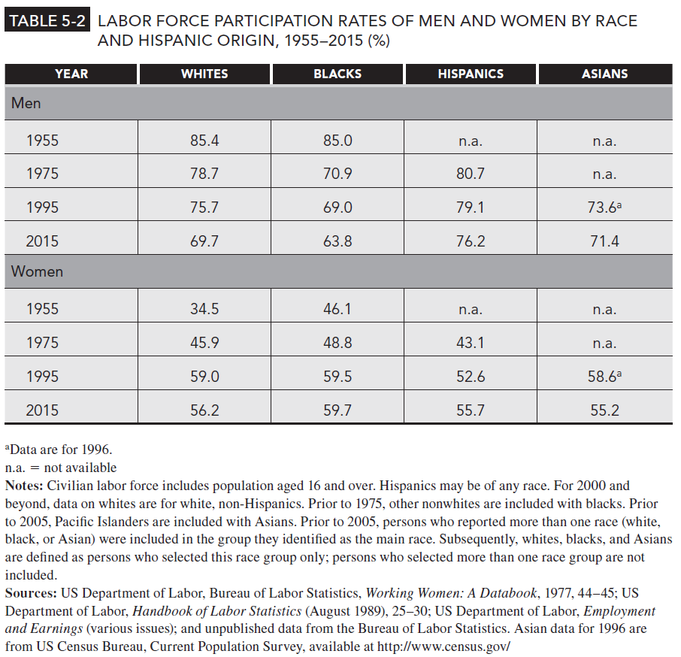
Table 5-2

Slide 7
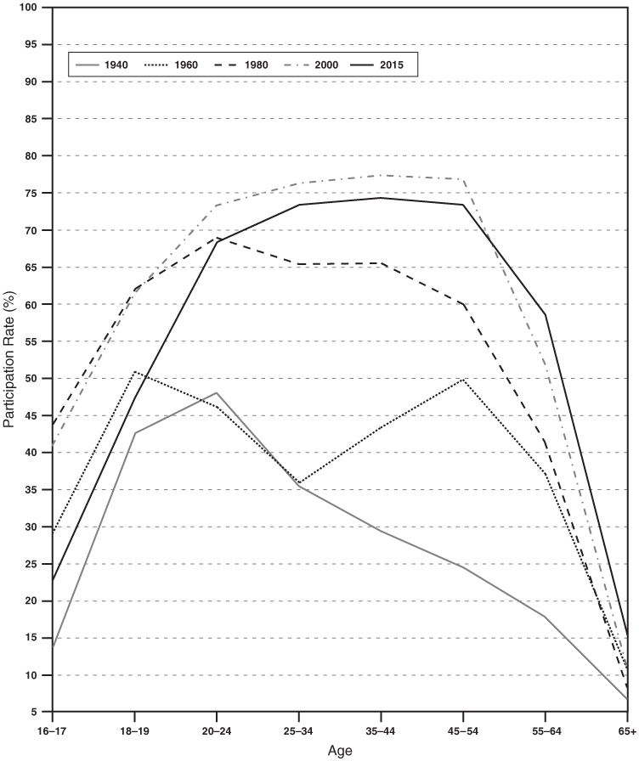
Figure 5-3
Labor Force Participation Rates of Women by Age
Source: US Department of Labor, Bureau of Labor Statistics, Employment and Earnings, Employment status of the civilian noninstitutional population by age, sex, and race, annual averages

Slide 8
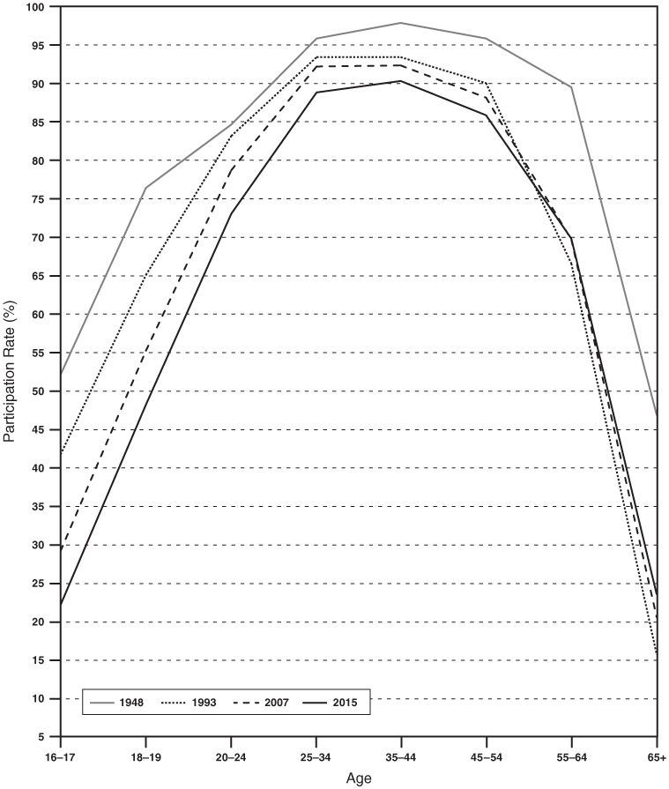
Figure 5-4
Labor Force Participation Rates
of Men by Age
Source: US Department of Labor, Bureau of Labor Statistics, Employment and Earnings, Employment status of the civilian noninstitutional population by age, sex, and race, annual averages

Slide 9
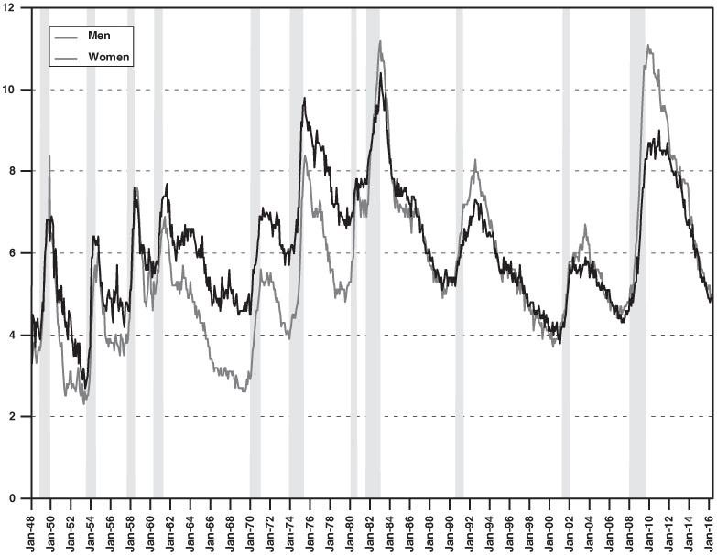
Figure 5-5
Unemployment Rates of Men and Women, 1948-2016
Notes: Unemployment data are seasonally adjusted. Vertical gray bars indicate the official dates of recession as determined by the National Bureau of Economic Research (NBER)
Sources: Unemployment data are for ages 16+ from the Bureau of Labor Statistics, Labor Force Statistics, based on CPS data, available at www.bls.gov (accessed April 9, 2016); NBER dating from Federal Reserve Economic Data, available at research.stlouisfed.org/fred2 (accessed July 7, 2016).

Slide 10
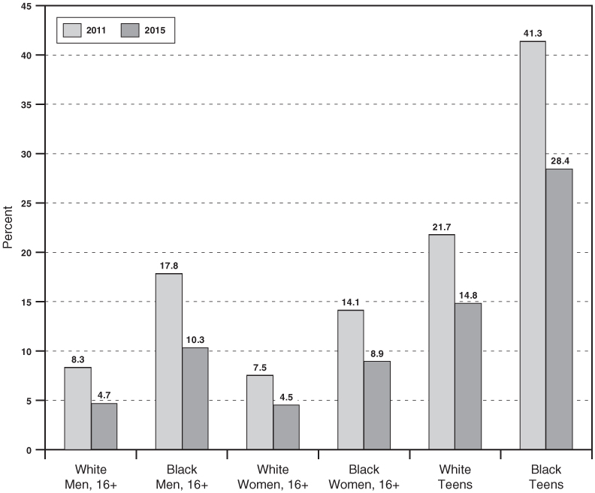
Figure 5-6
Unemployment Rates by Race for 2011 and 2015
Source: US Bureau of Labor Statistics, Labor Force Statistics from the CPS, available at www.bls.gov (accessed March 29, 2016)

