Slide 1
Chapter Three
The Family as an Economic Unit: Theoretical Perspectives

Slide 2
Figures and Tables

Slide 3
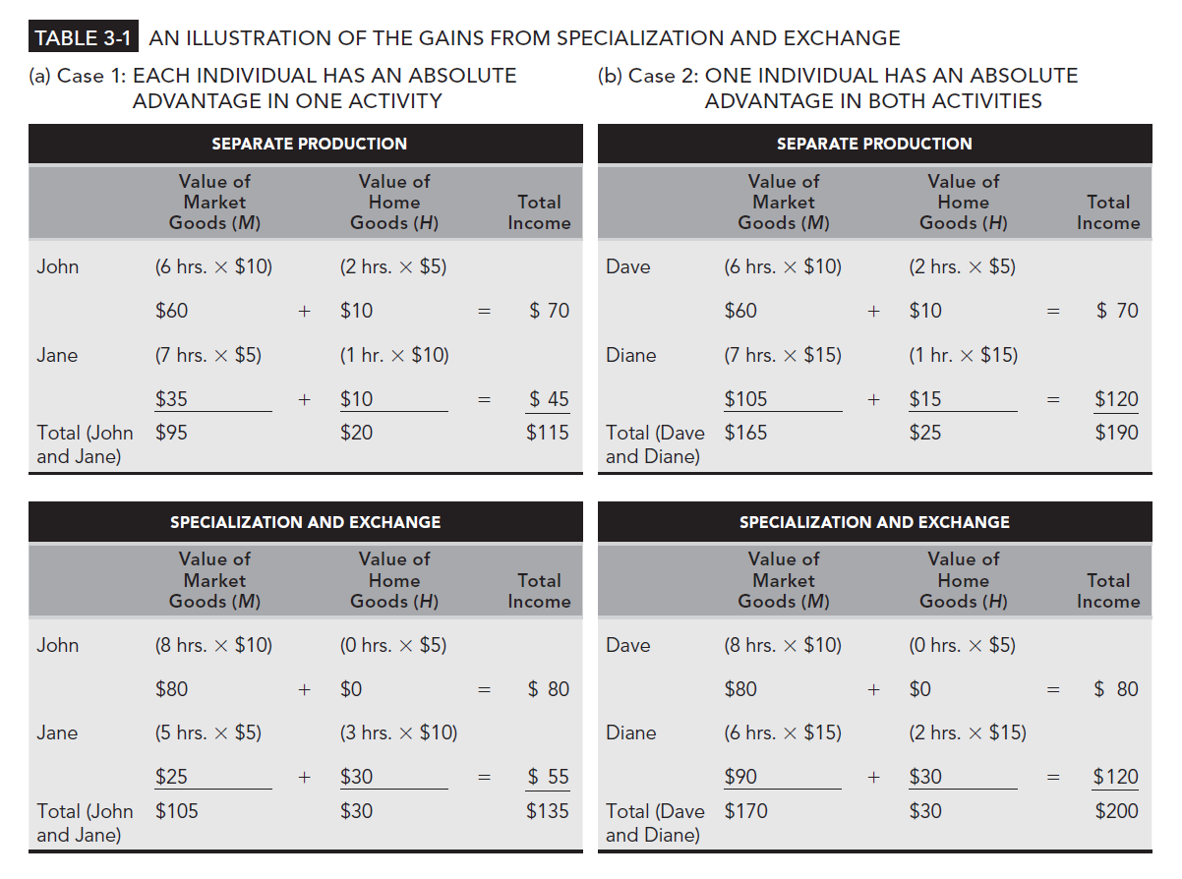
Table 3-1

Slide 4
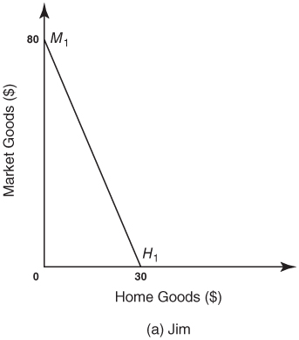
Figure 3-1a
Separate and Combined Production Possibility Frontiers

Slide 5
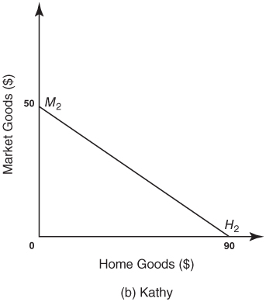
Figure 3-1b
Separate and Combined Production Possibility Frontiers

Slide 6
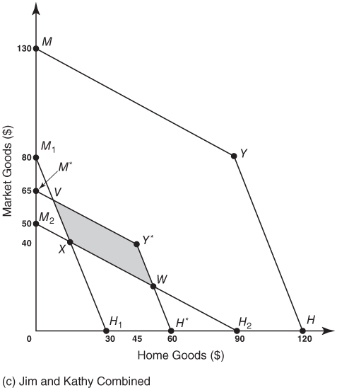
Figure 3-1c
Separate and Combined Production Possibility Frontiers

Slide 7
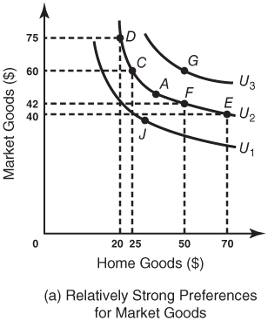
Figure 3-2a
Indifference Curves

Slide 8
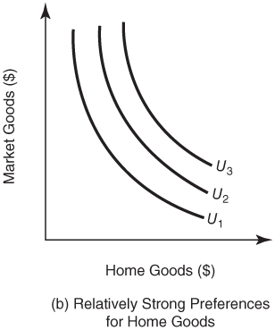
Figure 3-2b
Indifference Curves

Slide 9
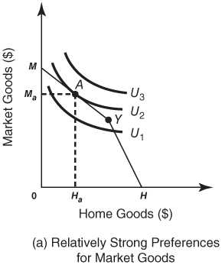
Figure 3-3a
The Role of Tastes in Determining the Household Division of Labor

Slide 10
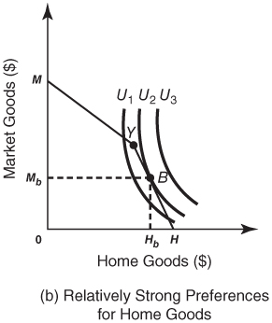
Figure 3-3b
The Role of Tastes in Determining the Household Division of Labor

Slide 11
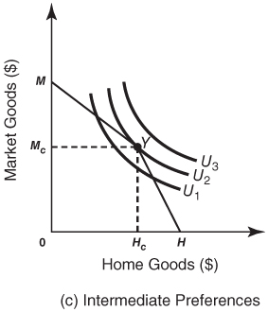
Figure 3-3c
The Role of Tastes in Determining the Household Division of Labor

Slide 12
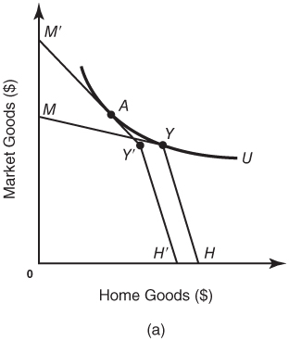
Figure 3-4a
The Role of the Production Possibility Frontier in Determining the Household Division of Labor

Slide 13
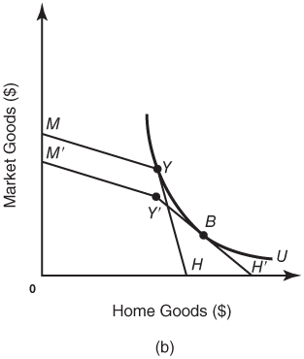
Figure 3-4b
The Role of the Production Possibility Frontier in Determining the Household Division of Labor

