Slide 1
Chapter Two
Women and Men: Historical Perspectives

Slide 2
Figures and Tables

Slide 3
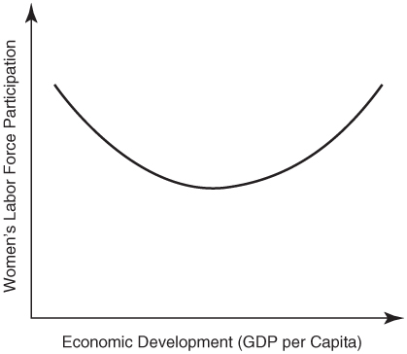
Figure 2-1
The U-Shaped Relationship between Women’s Labor Force Participation and Economic Development

Slide 4
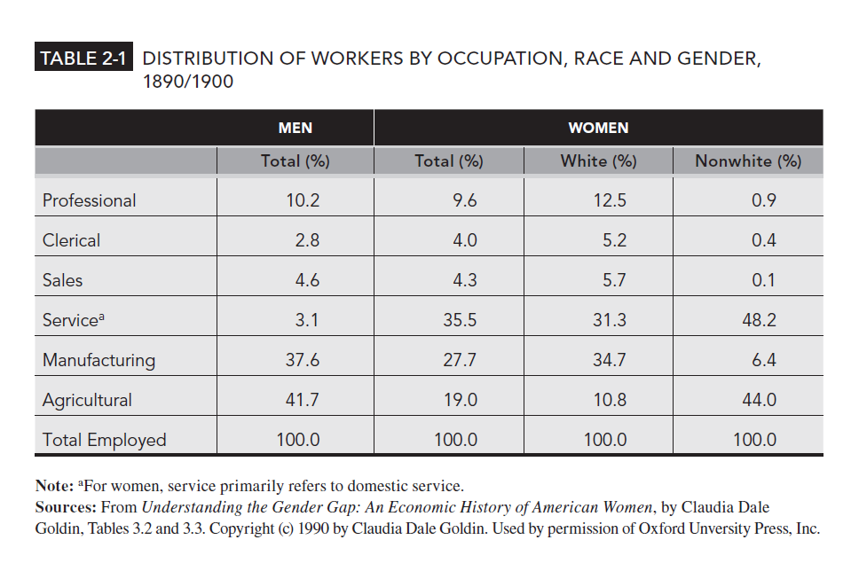
Table 2-1

