Slide 1
Chapter One
Introduction

Slide 2
Figures

Slide 3
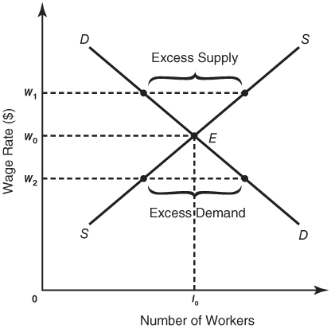
Figure 1-1
The Market for Clerical Workers

Slide 4
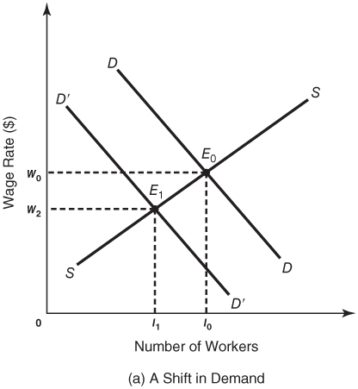
Figure 1-2a
An Illustration of Shifts in the Supply and Demand Curves

Slide 5
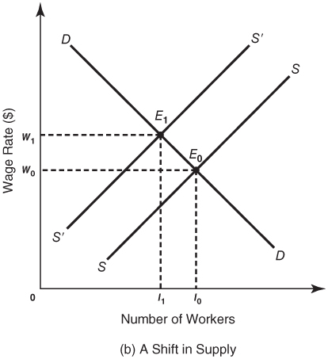
Figure 1-2b
An Illustration of Shifts in the Supply and Demand Curves

