Slide 1
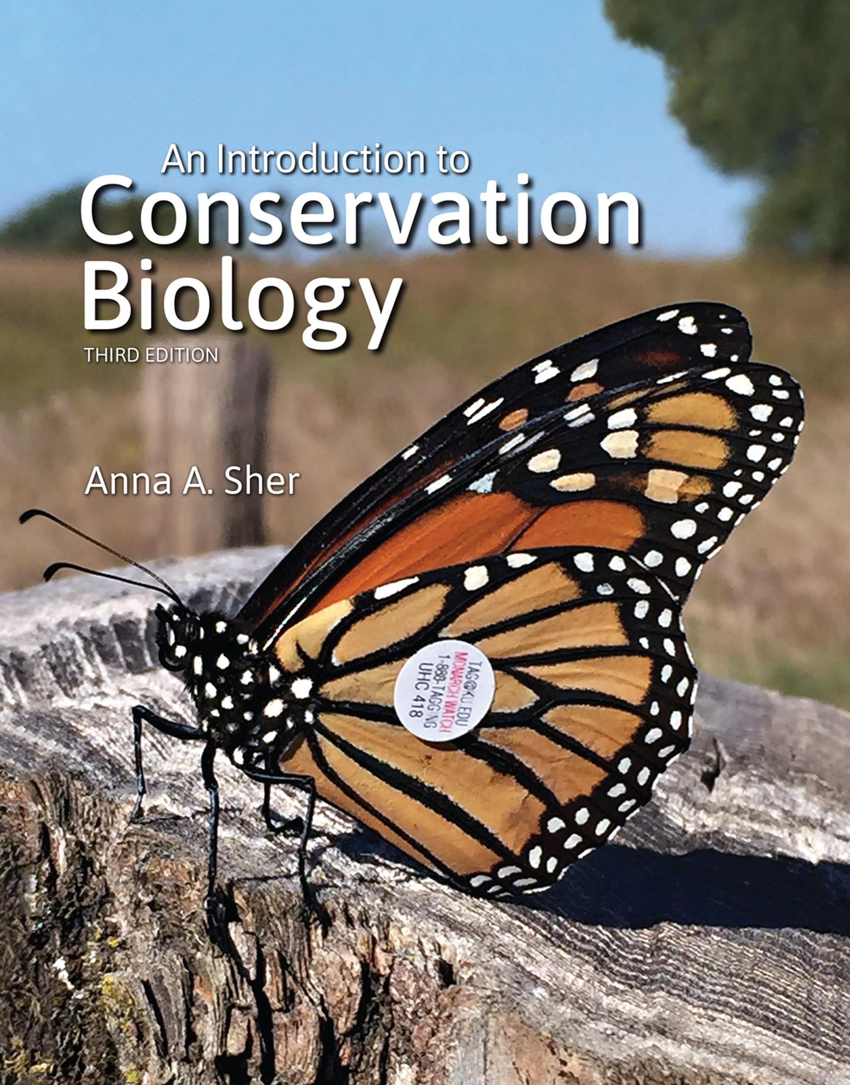
An Introduction to Conservation Biology
by Anna A. Sher

Slide 2
Chapter 5

Slide 3
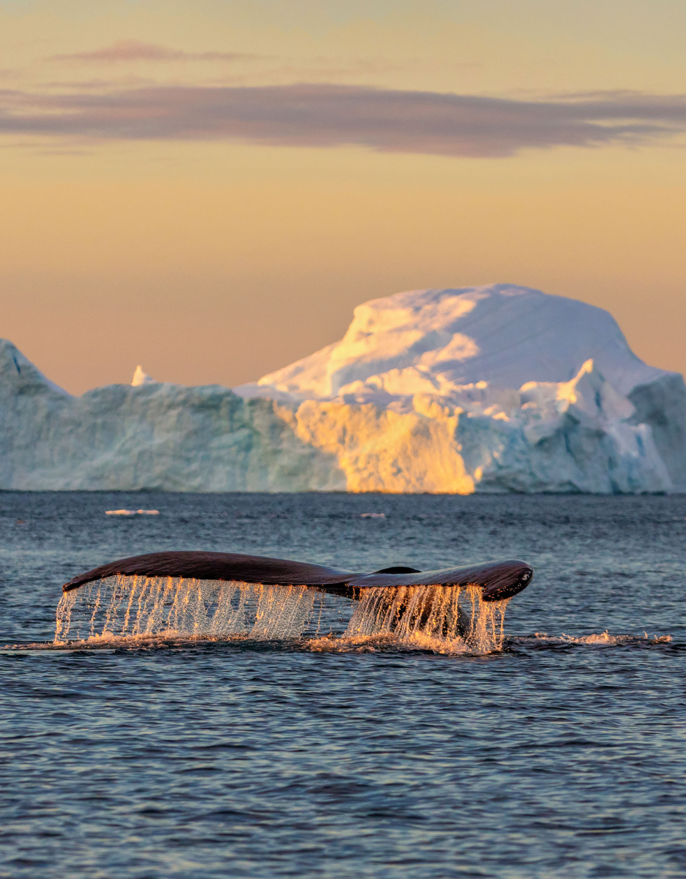
Chapter 5 Opener
Notes:
Ocean biodiversity has many threats. Among them, overexploitation is a primary concern for most marine endangered species; however, policies to limit harvesting have been successful in preventing several species from going extinct, including humpback whales (Megaptera novaeangliae). Climate change also directly impacts ocean life, including by reducing sea ice, upon which many marine mammals depend.

Slide 4
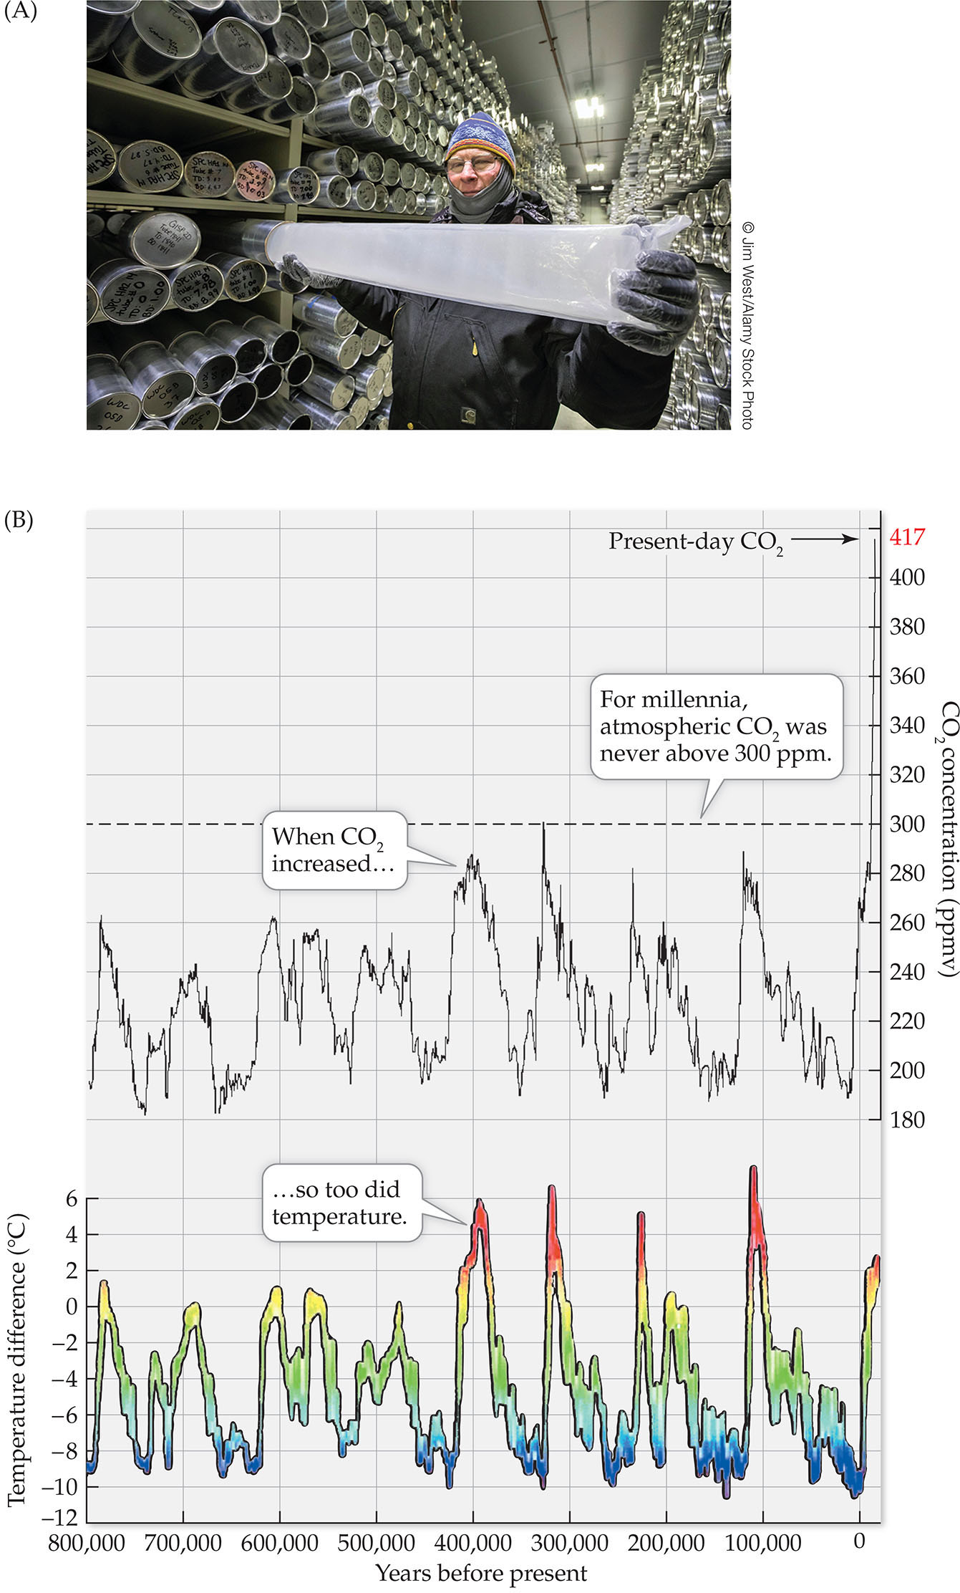
Figure 5.1
Notes:
FIGURE 5.1 (A) By analyzing air bubbles trapped in ice cores, scientists can determine the climate that existed even hundreds of thousands of years ago. (B) Ice cores sampled in Vostok, Antarctica, revealed that temperature has fluctuated as much as 11°C over the past 800,000 years and that these fluctuations closely mirrored carbon dioxide measurements. More recent data are collected from direct measurements. (B, after D. Lüthi et al. 2008. Nature 453[7193]: 379–382. https:// doi.org/10.1038/nature06949, and J. Jouzel et al. 2007. Science 317 [5839]: 793–796. Reprinted with permission from AAAS. https:// doi.org/10.1126/science.1141038.)

Slide 5
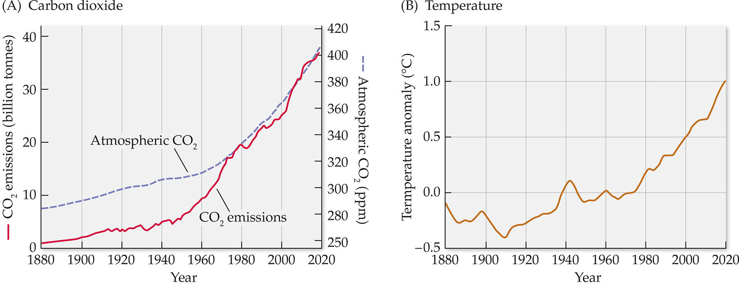
Figure 5.2
Notes:
FIGURE 5.2 In modern times we are able to measure not only annual mean temperature and mean atmospheric carbon dioxide directly, but also industrial emissions. We can see here that all three of these measures have increased at similar rates, illustrating the contribution of fossil fuel use to atmospheric CO2, and also how this is impacting global temperature. Measurements and calculations taken by different groups of scientists are consistent (Tollefson 2018). (A, after NOAA Climate.gov [https://www.climate.gov/media/12990], adapted from original by Howard Diamond [NOAA ARL]. Atmospheric CO2 data from NOAA and ETHZ. CO2 emissions data from Our World in Data [https://ourworldindata.org/ co2-and-other-greenhouse-gas-emissions] and the Global Carbon Project. B, after https://climate.nasa.gov/ vital-signs/global-temperature.)

Slide 6
TABLE 5.1
1. INCREASED TEMPERATURES AND INCIDENCE OF HEAT WAVES Example: 2020 (tied with 2016) was the hottest year worldwide in the historical record so far.
2. MELTING GLACIERS AND POLAR ICE Example: Arctic Ocean summer ice has declined in area by 15% over the past 25 years. September 2020 had the second-lowest extent of sea ice recorded. Since 1850, glaciers in the European Alps have disappeared from more than 30%–40% of their former range.
3. RISING SEA LEVEL Example: Since 1938, one-third of the coastal marshes in a wildlife refuge in the Chesapeake Bay have been submerged by rising seawater.
4. EARLIER SPRING ACTIVITY Example: One-third of English birds are now laying eggs earlier in the year, and two-thirds of temperate plant species are flowering earlier than they did several decades ago
5. SHIFTS IN SPECIES RANGES Example: Two-thirds of European butterfly species studied are now found 35–250 km farther north than recorded several decades ago.
6. POPULATION DECLINES Example: Adélie penguin populations have declined over the past 25 years as their Antarctic sea ice habitat melts away.
Sources: Union of Concerned Scientists (www.ucsusa.org), NASA, and NOAA.
Notes:
TABLE 5.1 Some Effects of Global Warming

Slide 7
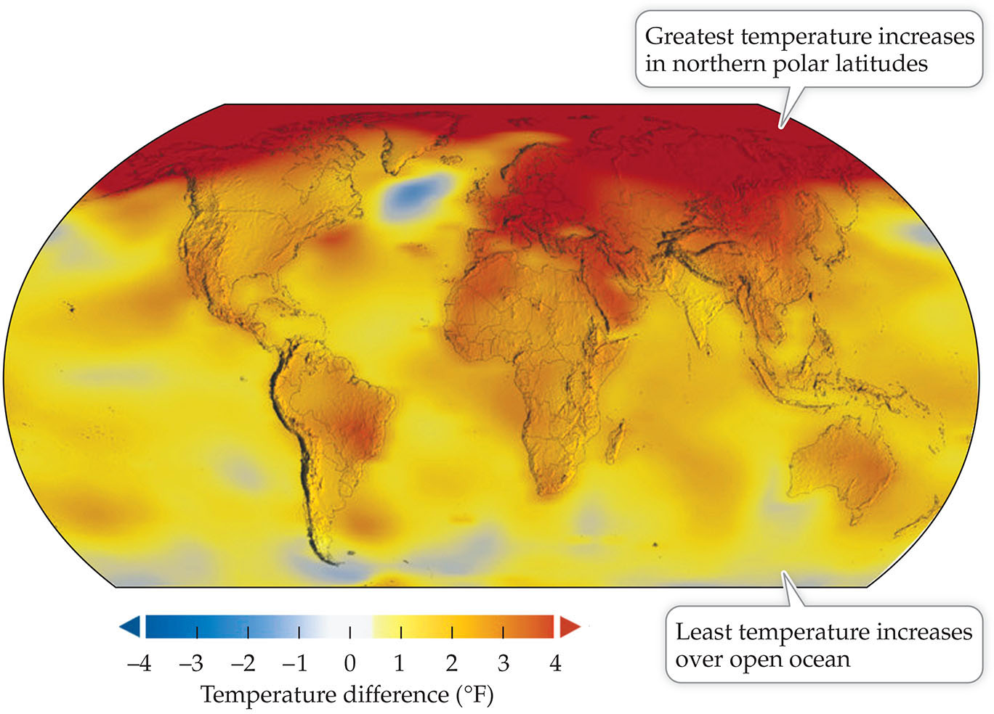
Figure 5.3
Notes:
FIGURE 5.3 Global temperature differences from average, for 2020. Here, temperature changes are reported in terms of difference (anomaly) from the average annual temperature from 1951 to 1980. Note that temperature changes differ across the surface of the Earth, with the greatest temperature increases at northern latitudes. At publication of this edition, the latest data were for 2020, which tied with 2016 as the hottest year on record. (From NASA/GISS, Scientific Visualization Studio. 2020. https://climate.nasa.gov/ vital-signs/global-temperature.)

Slide 8
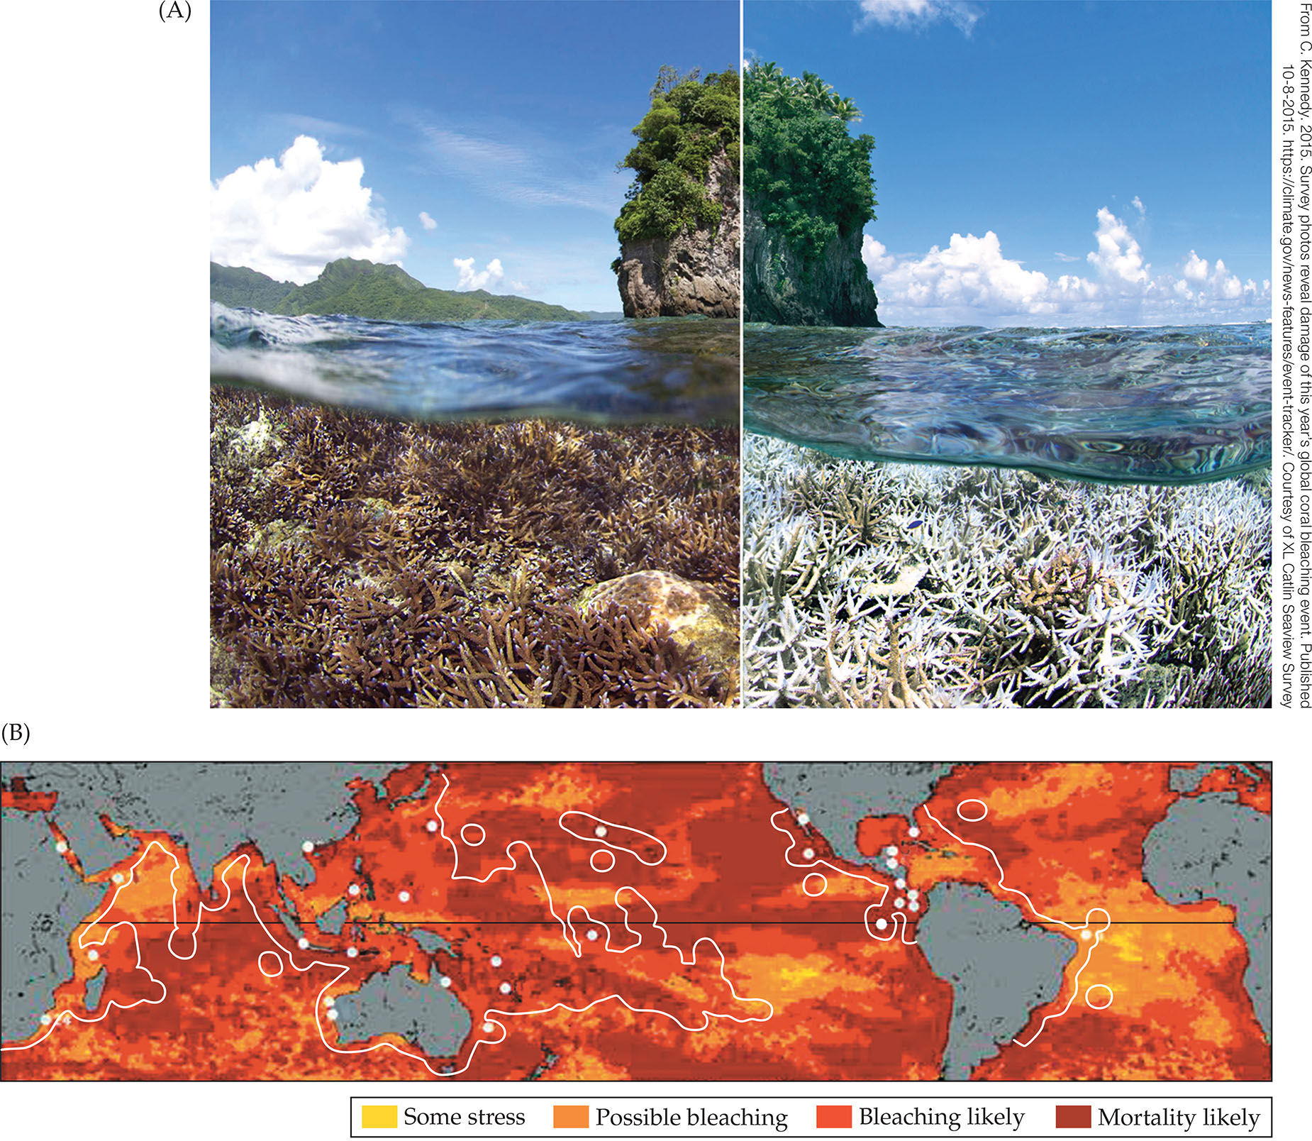
Figure 5.4
Notes:
FIGURE 5.4 High ocean temperatures cause corals to expel the symbiotic algae that provide them with food. (A) The 2015 coral bleaching event had dramatic effects on this reef in American Samoa. The photo on the left was taken in December 2014, the one on the right in February 2015. The photos were taken by the XL Catlin Seaview Survey, a group documenting bleaching across the globe. (B) Temperature increases that threaten coral reefs can be tracked using satellite data. Here, we can see that for the period June 2014—April 2017, more than 70% of the Earth’s seas experienced conditions that usually cause coral mortality. Furthermore, most of the seas of American Samoa reached this point at least twice during this period, making it the worst coral bleaching event on record. Major coral reef regions are outlined here, with World Heritage sites (i.e., reefs of particular biological or cultural significance) indicated with dots. Corals begin to starve after bleaching, but some may recover if conditions improve. The NOAA Coral Reef Watch program uses surface temperature data collected by satellite to determine where managers should focus efforts. Global warming is the leading cause of coral bleaching. (After NOAA Coral Reef Watch 2017 and L. Burke et al. 2011. Reefs at Risk Revisited. World Resources Institute, Washington, DC. CC BY 4.0.)

Slide 9
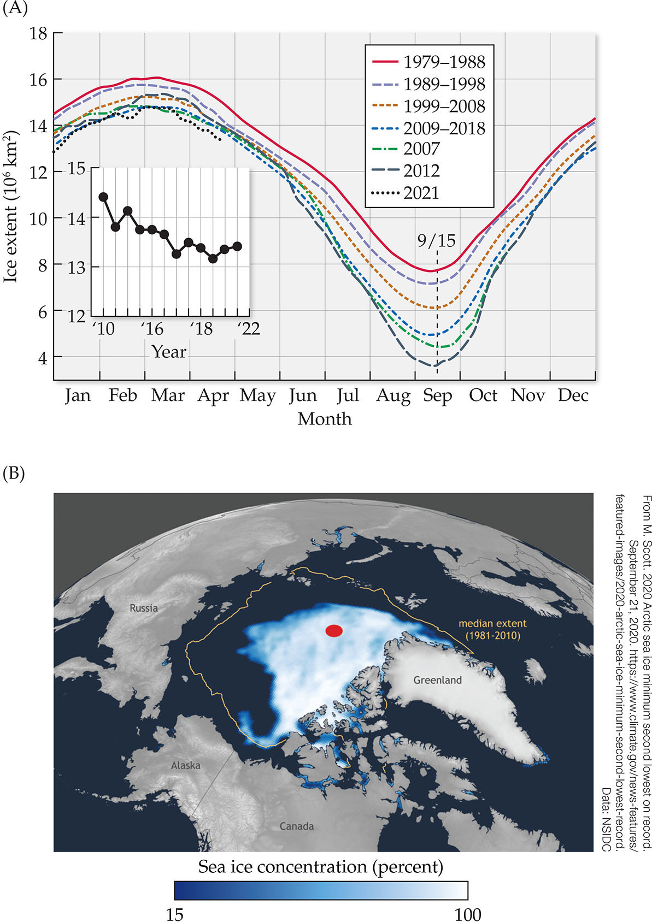
Figure 5.5
Notes:
FIGURE 5.5 (A) All climate models predict that the greatest warming will take place in the northern polar regions. The graph shows satellite-data-derived measurements of the extent of arctic sea ice cover by month, for selected years from 1979 to April 2021. The inset shows how the ice extent has decreased over time for the month of April. (B) The satellite-derived map shows the Arctic sea ice extent (in white) in summer of 2020 as compared with the median modern ice edge between 1981 and 2010 (yellow outline). The red dot marks the North Pole. (A, after J. C. Comiso et al. Current state of sea ice cover. Accessed April 2021. https://earth.gsfc.nasa.gov/cryo/ data/current-state-sea-ice-cover.)

Slide 10
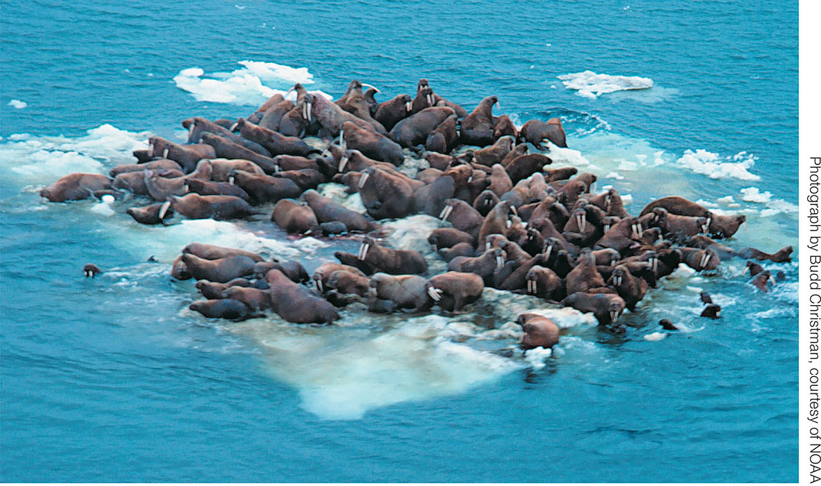
Figure 5.6
Notes:
FIGURE 5.6 Polar ice caps are melting at alarming rates, as these walrus crowded onto an ice floe in the Bering Sea off Alaska seem to attest.

Slide 11
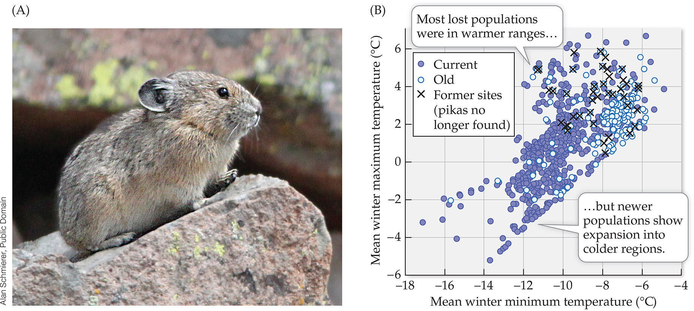
Figure 5.7
Notes:
FIGURE 5.7 (A) American pikas (Ochotona princeps, a relative of the rabbit) live at high altitudes and so are the subject of concern in the face of warming climates. (B) A survey of 2387 sites throughout the Great Basin was compared with historical records of pikas (“old sites”), including where they were known to be extirpated. All extirpated sites were in warmer, drier regions. Although this may appear to be bad news in a warming climate, these data also show that the species appears to be adapting to a wider range of tolerated climates, possibly indicating an evolutionary trend that could help the species adapt. (B, after C. I. Millar et al. 2018. Arct Antarct Alp Res 50: e1436296. https://doi.org/10.1080/15230430.2018.1436296. CC BY 4.0. https://creativecommons.org/licenses/by/4.0.)

Slide 12
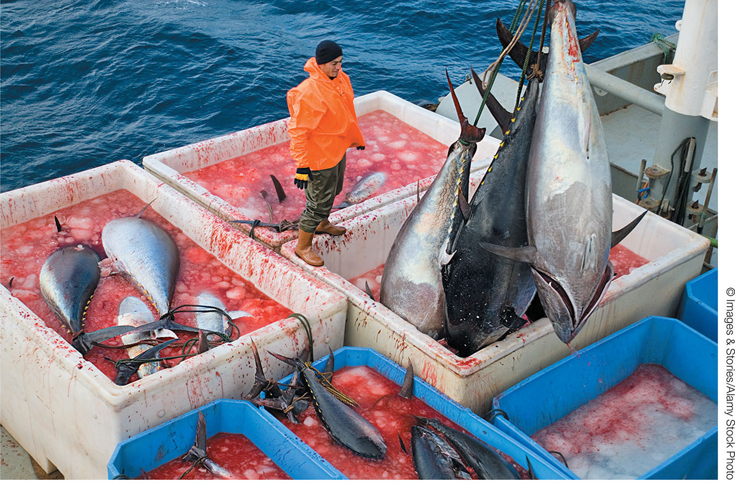
Figure 5.8
Notes:
FIGURE 5.8 Intensive harvesting has reached crisis levels in many of the world’s fisheries. These bluefin tuna (Thunnus thynnus) are being transferred from a fishing trawler to a factory ship, aboard which huge quantities of fish are efficiently processed for human consumption. Such efficiency can result in massive overfishing.

Slide 13
Figure 5.9
Notes:
FIGURE 5.9 Orchids are the most extensively traded taxonomic group on the CITES watch list. They are extremely popular ornamental plants, the showiest of which originate in the tropics. The trade of all species of orchids is tracked by international agreement.

Slide 14
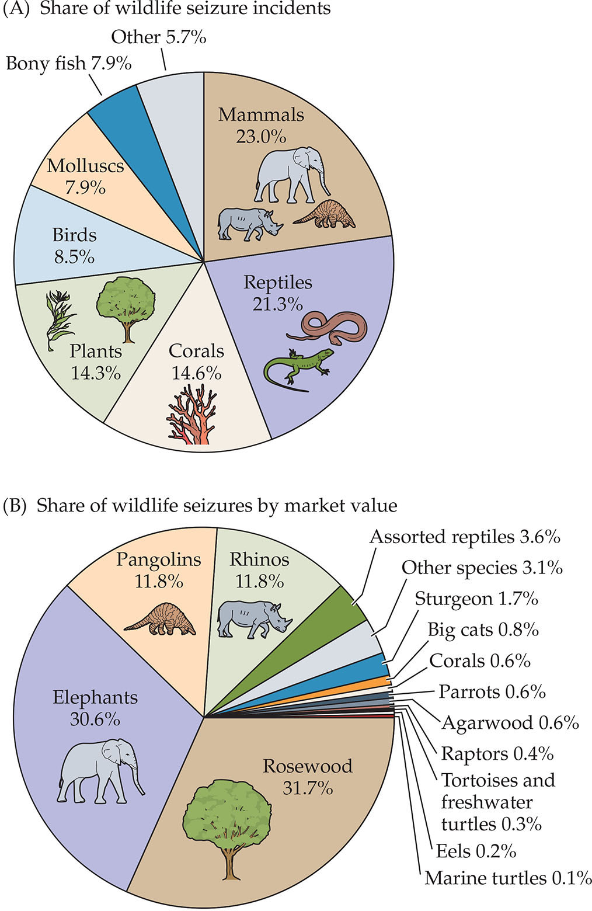
Figure 5.10
Notes:
FIGURE 5.10 Major groups illegally traded, worldwide. (A) Share of all seizure incidents in the World WISE database, by taxonomic category, aggregated 1999–2018. (B) Share of total seizures, by type (aggregated on the basis of standard value), 2014–2018. (After UNODC 2020. World Wildlife Crime Report 2020: Trafficking in Protected Species. United Nations Office on Drugs and Crime. Data: UNODC World WISE Database.)

Slide 15
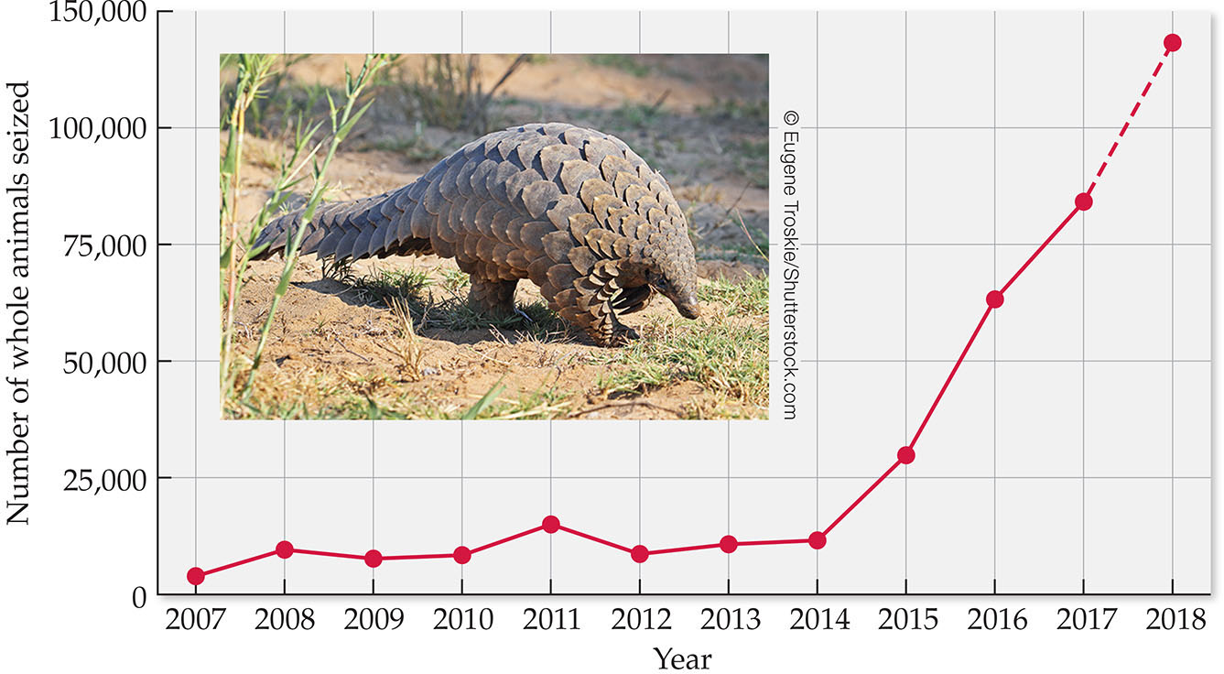
Figure 5.11
Notes:
FIGURE 5.11 The ant-eating pangolin (eight species in the family Manidae) has become the most illegally trafficked animal in the world, with number of individuals seized at borders increasing dramatically beginning in 2014. The number for 2018 is estimated. (After UNODC 2021. Wildlife Crime: Pangolin Scales, 2020. United Nations Office on Drugs and Crime. Data: World WISE.)

Slide 16
TABLE 5.2
Species | Numbers prior to whalingª | Present numbers | Primary diet | IUCN status^{b}
BALEEN WHALES
Blue | 200,000 | 5,000–15,000 | Plankton | Endangered
Bowhead | 56,000 | 10,000 | Plankton | Least concern
Fin | 475,000 | 100,000 | Plankton | Vulnerable
Gray (Pacific stock) | 23,000 | 15,000–22,000 | Crustaceans | Least concer
Humpback | 150,000 | 84,000 | Plankton, fish | Least concern
Minke | 140,000 | 200,000 | Plankton, fish | Least concern
Northern right | Unknown | 450 | Plankton | Endangered
Sei | 250,000 | 50,000 | Plankton, fish | Endangered
Southern right | 100,000 | 10,000 | Plankton | Least concern
TOOTHED WHALES
Beluga | Unknown | 136,000 | Fish, squid, crustaceans | Least concern
Narwhal | Unknown | 123,000 | Fish, squid, crustaceans | Least concern
Sperm | 1,100,000 | 300,000–450,000 | Fish, squid | Vulnerable
Sources: IUCN Red List of Threatened Species 2018, NOAA Fisheries 2019. ªPre-exploitation population numbers are highly speculative. Genetic evidence suggests the populations may have been greater. ^{b}Status is determined by a combination of numbers, threats, and trends. For example, numbers of southern right whales are low but are increasing.
Notes:
TABLE 5.2 Worldwide Populations of Whale Species Harvested by Humans

Slide 17
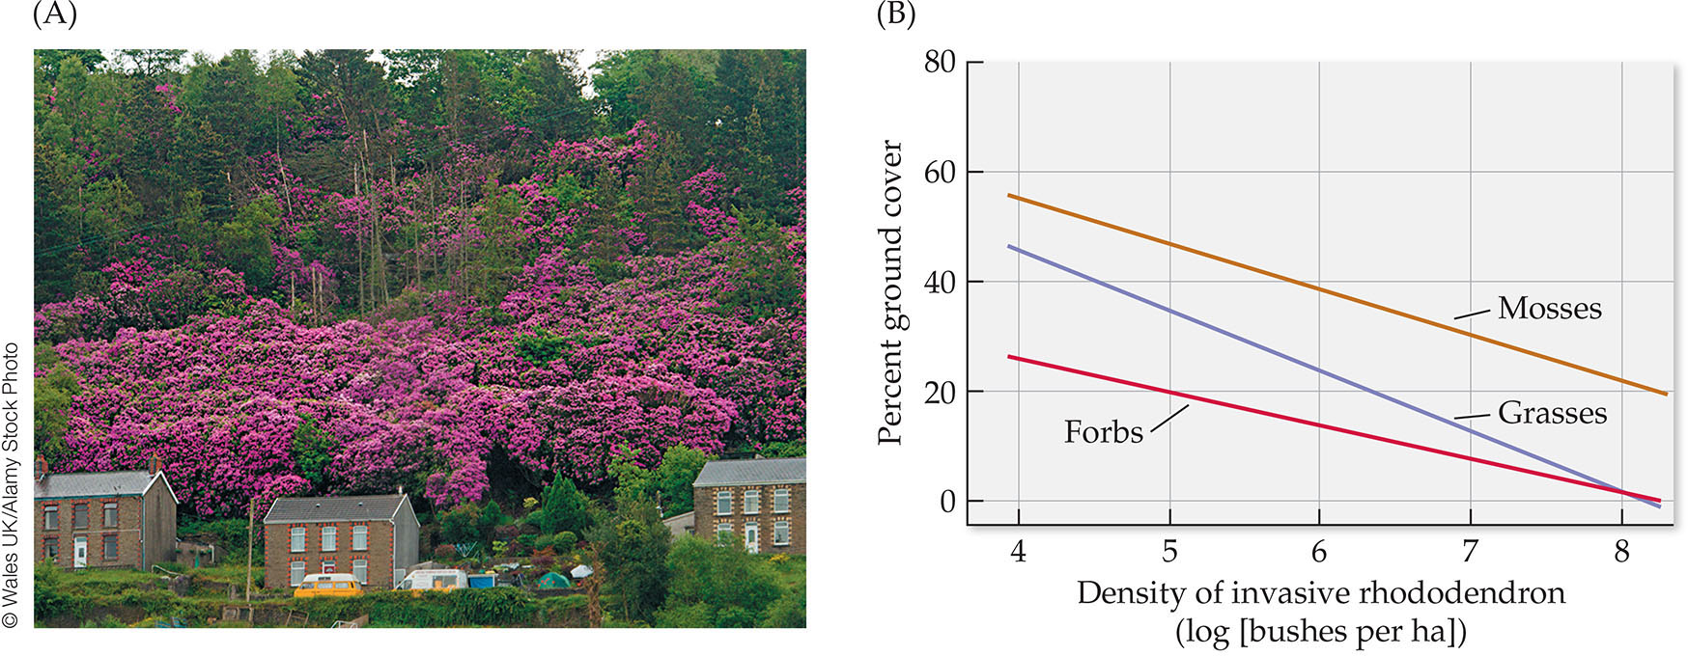
Figure 5.12
Notes:
FIGURE 5.12 Some invasive plants competitively exclude nearly all other species. (A) Pontic rhododendron (Rhododendron ponticum) is native to southern Europe and southwest Asia but has become invasive in the United Kingdom, particularly in the oak woodland of western Scotland, an ecosystem with high conservation importance. (B) Researchers found that with increasing density of rhododendron, grasses, forbs (broad-leaved plants), and mosses all decreased. (B, after J. E. Maclean et al. 2018. J Appl Ecol 55(2): 874–884. © 2017 The Authors. Journal of Applied Ecology. © 2017 British Ecological Society.)

Slide 18
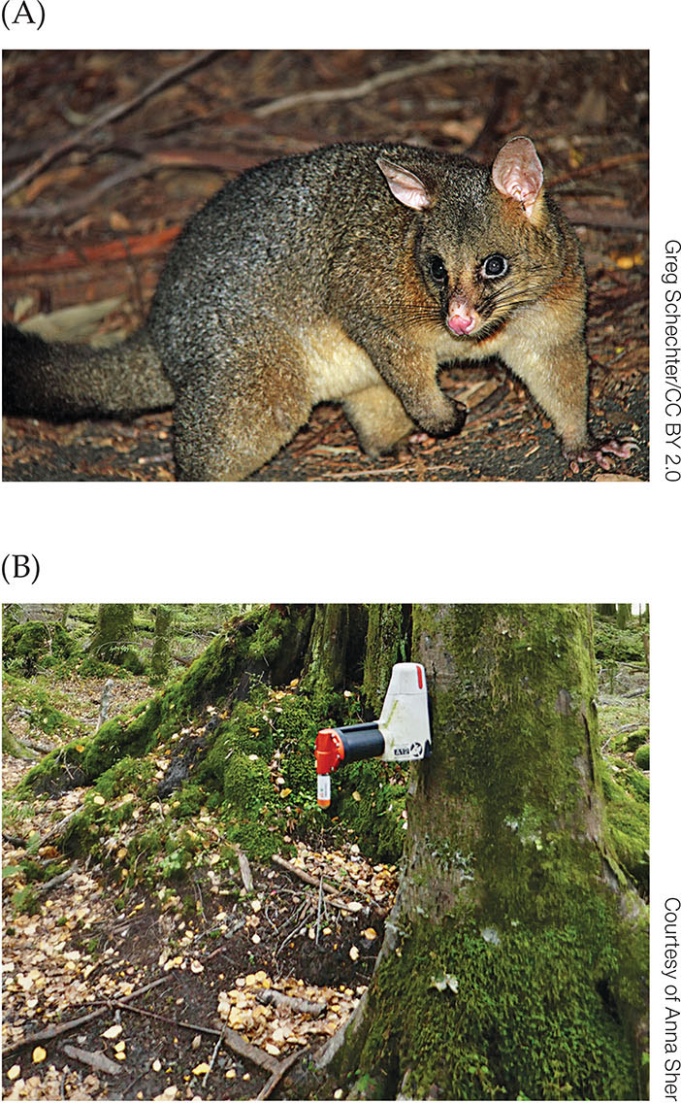
Figure 5.13
Notes:
FIGURE 5.13 (A) The common brushtail possum was introduced from Australia to New Zealand in 1837 and has since become a significant threat to native species. The possums are omnivores that prey on bird eggs and invertebrates and compete with native species for food. (B) A new method of control is being employed that instantly kills the possum when, attracted by a scent bait, it inserts its head looking for food. The benefit of this type of trap is that it is more humane than poison plus is self-resetting, able to discharge several times.

Slide 19
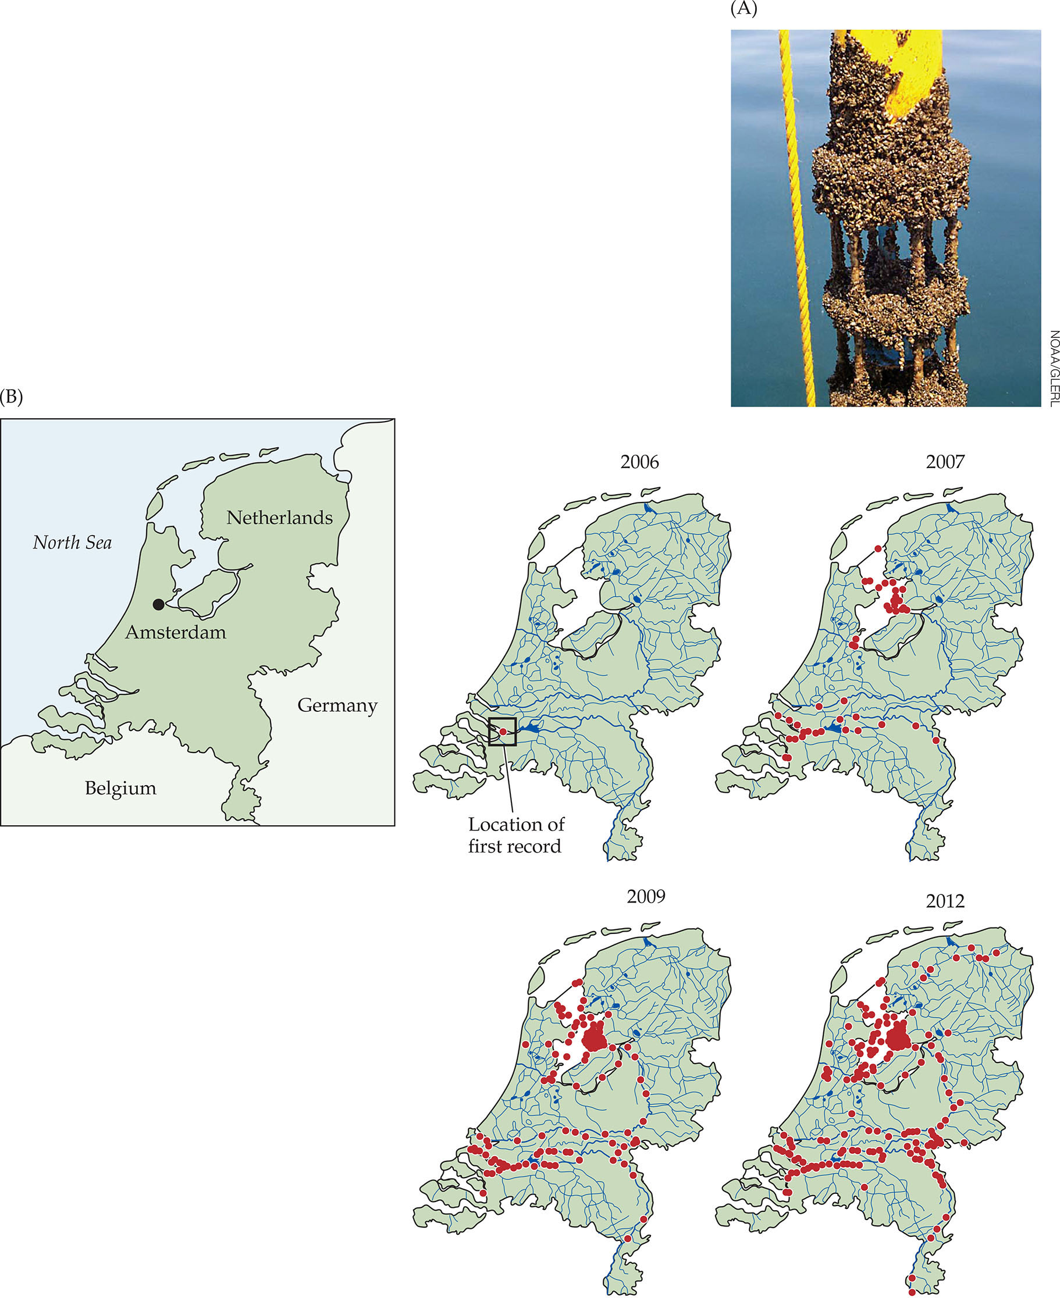
Figure 5.14
Notes:
FIGURE 5.14 Invasive mollusks are a significant problem in many lakes. (A) For example, zebra mussels (Dreissena polymorpha) spread very quickly, covering native species and clogging pipes. They are dispersed in part by attaching themselves to boats. (B) These maps show the rapid spread of a similar species, the Eastern European quagga mussel (Dreissena rostriformis bugensis) in the Netherlands since it was first detected in the Rhine-Meuse estuary in 2006. In Europe, the quagga mussel has traveled between 23 and 383 km/y (mean 120 ± 53.8 km/y). (B, after J. Matthews et al. 2014. Biol Invasions 16: 23. https://doi.org/10.1007/ s10530-013-0498-8.)

Slide 20
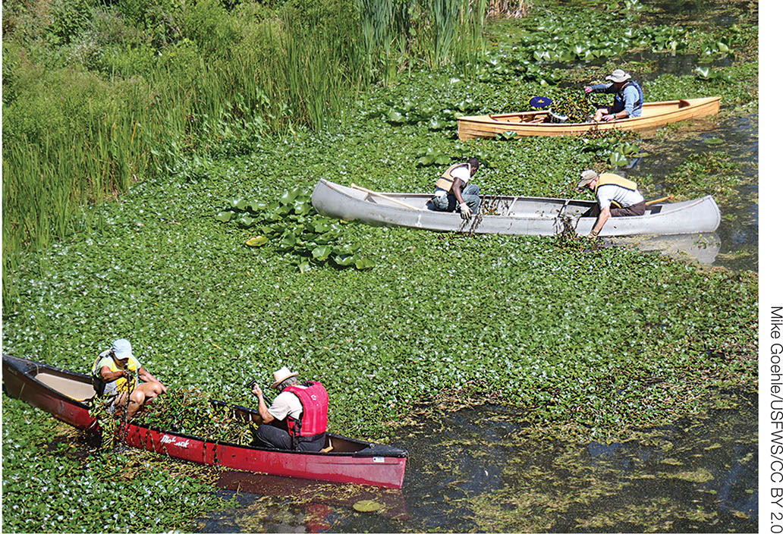
Figure 5.15
Notes:
FIGURE 5.15 Every year volunteers remove Eurasian water chestnut, an invasive floating plant, from the Mystic River in northeastern Massachusetts. Floating invasive plants like this one create thick mats that exclude native aquatic plants that provide habitat and food for native fish and other animals. They are also bad for animals that require open water to forage, such as eagles. This effort has been successful in removing thousands of “baskets” of the weed annually since 2010, with good results.

Slide 21
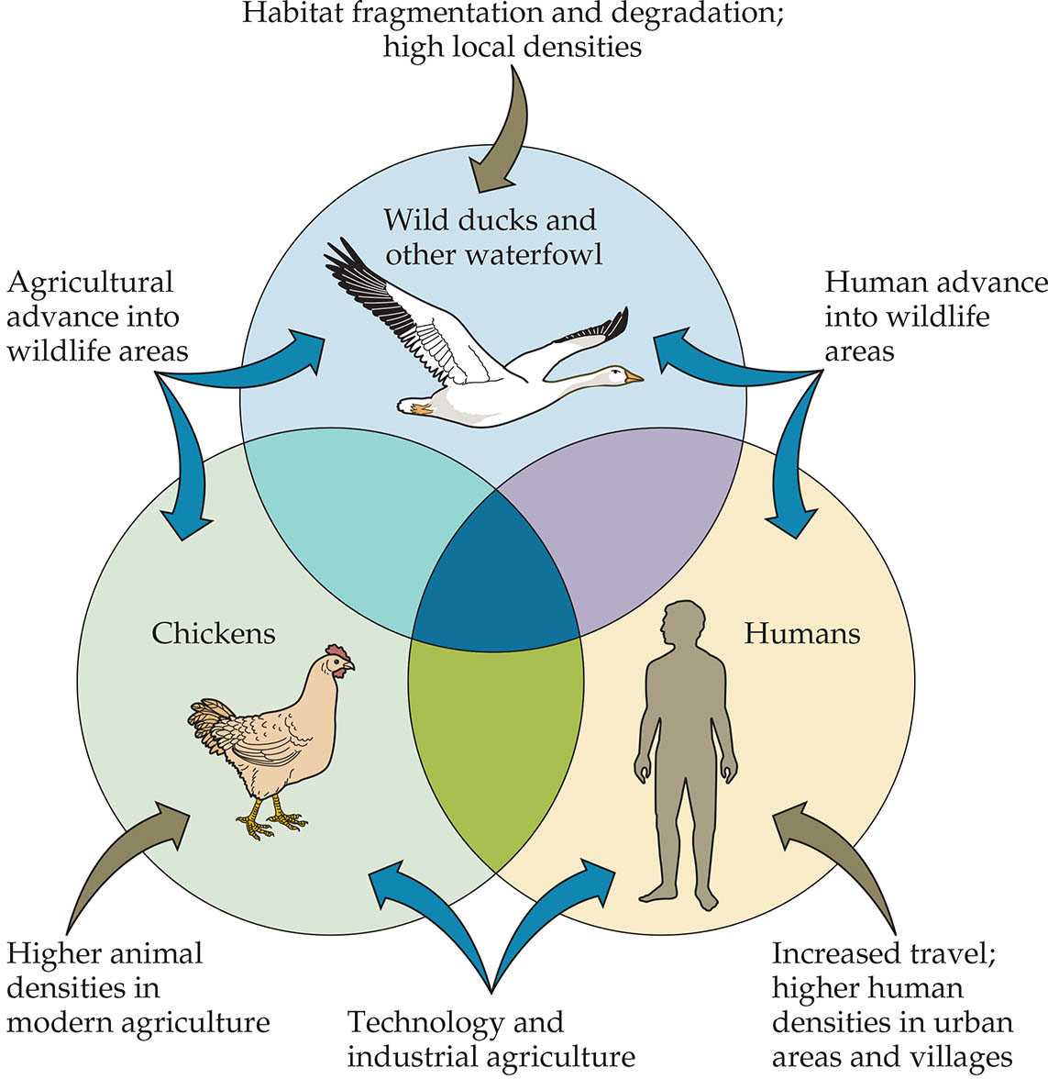
Figure 5.16
Notes:
FIGURE 5.16 Infectious diseases (such as rabies, Lyme disease, influenza, bird flu, hantavirus, and canine distemper) spread among wildlife populations, domesticated animals, and humans as a result of increasing population densities and the advance of agriculture and human settlements into wild areas. This diagram illustrates the infection and transmission routes of bird flu, which is caused by a virus that infects wild waterfowl, chickens, and humans. The shaded areas of overlap indicate that the disease can be shared among the three groups. Single arrows indicate factors contributing to higher rates of infection; double arrows indicate factors contributing to the spread of disease among the three groups. (After P. Daszak et al. 2000. Science 287: 443–449.)

Slide 22
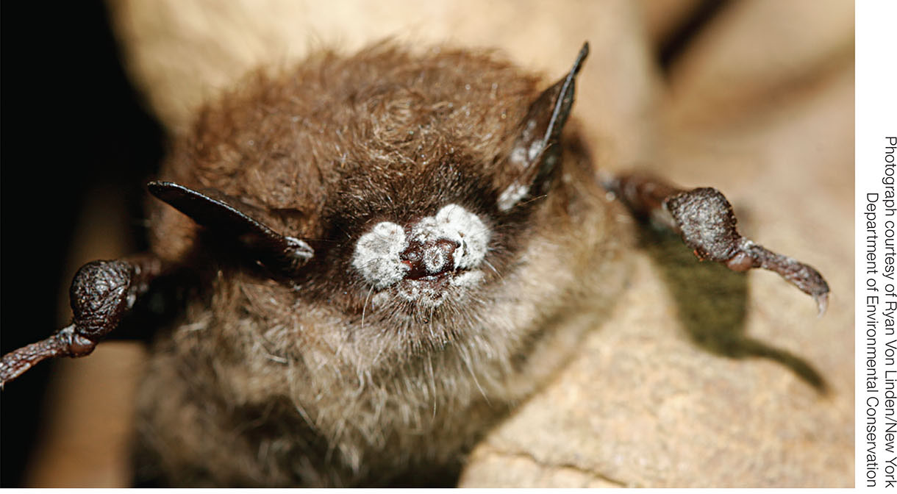
Figure 5.17
Notes:
FIGURE 5.17 A little brown bat (Myotis lucifugus) infected with white-nose syndrome is being examined by a researcher. This fungal disease, which first appeared in the United States in 2006, affects a variety of bat species and has killed up to 90% of the bats in many caves.

